Slide 1
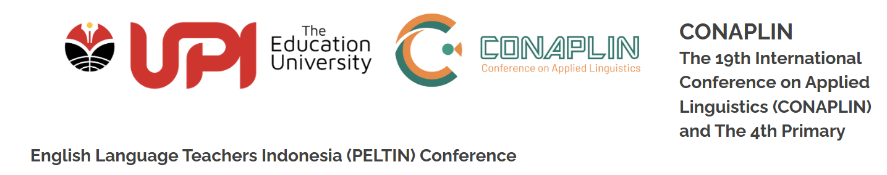

Exploring Technology-Enhanced CLIL in Secondary Biology: Effects on Content Learning and Scientific Discussion
Dr Sahrunizam & Dr Yong CC

Slide 2
Background
Increasing integration of digital technology in education
CLIL combines subject learning and academic language development
Limited understanding of how digital learning supports scientific discussion

Slide 3
Research Gap
Limited empirical studies on TECH-CLIL
Few studies examining scientific discussion
Limited use of mixed-methods approaches

Slide 4

Research Aim: to examine the effects of TECH-CLIL on:
🟥 Biology Content Knowledge
- Understand Biology concepts
- Apply scientific knowledge
🟨 Scientific Discourse Competence
- Explain ideas clearly
- Use correct scientific terms
- Organise ideas logically
- Communicate scientifically
🟩 Scientific Discussion
- Discuss scientific ideas
- Ask and answer questions -
- Justify explanations
- Learn together
Notes:
This study examined the effects of TECH-CLIL on three learning outcomes. First, Biology content knowledge, which refers to students' understanding of Biology concepts. Second, Scientific Discourse Competence, which is students' ability to communicate scientific ideas clearly using correct scientific vocabulary, logical organisation, and appropriate scientific language. This was measured through students' written scientific responses. Third, Scientific Discussion, which focuses on how students communicated, explained, questioned, and built ideas together during classroom discussions. This was explored through qualitative analysis of collaborative learning.

Slide 5

Research Questions
Is there a statistically significant difference in biology content knowledge between students in TECH-CLIL and traditional CLIL conditions?
Is there a statistically significant difference in Scientific Discourse Competence between students experiencing the TECH-CLIL approach and those receiving traditional CLIL instruction?
How does students’ participation in scientific discourse differ between the TECH-CLIL and traditional CLIL learning environments?

Slide 6
Research Design
Quasi-experimental (pre-test–post-test)
Mixed methods approach
Integration at interpretation stage

Slide 7
Participants
N = 75 Year 10 students
TECH-CLIL (n = 40)
Traditional CLIL (n = 35)

Slide 8
Intervention
4-week biology module
Topics: cells & classification
TECH-CLIL instruction
vs
traditional CLIL instruction

Slide 9
Instruments
Biology content test
Scientific discourse Competence
Classroom scientific discourse

Slide 10
Data Analysis
Data Analysis & Results
Research Questions | Analysis | Results
Biology content knowledge | ANCOVA / t-test | TECH-CLIL group achieved significantly higher biology content knowledge scores than students in the traditional CLIL group
Scientific Discourse Competence | ANCOVA / rubric scores | indicating that students' baseline performance contributed significantly to post-intervention scores.
Scientific discourse | Thematic analysis of group discussions | Students in the TECH-CLIL group demonstrated richer scientific discourse, more accurate disciplinary vocabulary, and stronger evidence-based reasoning.

Slide 11
Results: Biology Content Knowledge
Significant group difference
F(1, 72) = 53.69, p < .001
Large effect size
Partial η² = .43
TECH-CLIL group achieved higher adjusted mean scores
Research Question 1
The findings indicate that students in the TECH-CLIL group achieved significantly higher biology content knowledge scores than students in the traditional CLIL group.

Slide 12
Results: Biology Content Knowledge
Significant group difference
F(1, 72) = 86.55, p < .001
Very large effect size
Partial η² = .55
TECH-CLIL students demonstrated stronger scientific discourse competence
Research Question 2
The findings indicate that the TECH-CLIL intervention supported stronger scientific discourse competence, indicating that students' baseline performance contributed significantly to post-intervention scores.
Results: Scientific Discourse Competence

Slide 13
Results: Scientific Discussion
More developed scientific explanations
More accurate use of scientific vocabulary
More collaborative scientific discussion
Students gave longer explanations with clearer reasoning and examples.
Students used scientific terms more precisely during discussions.
Students built on peers’ ideas and asked clarification questions.
Research Question 3
The thematic analysis showed that students in the TECH-CLIL condition engaged in more developed scientific discussion and collaborative explanation during classroom interaction.

Slide 14

Integrated Interpretation of Findings
Quantitative Findings
Qualitative Findings
Mixed Methods Integration
Better biology content knowledge.
More detailed scientific explanations.
The qualitative findings corroborated the quantitative gains, showing that TECH-CLIL supported both learning and scientific classroom interaction.
Students' baseline performance contributed significantly to post-intervention scores.
Significant improvement in TECH-CLIL group
Better use of scientific vocabulary.
More active collaborative discussion

Slide 15
Discussion
Digital learning supported scientific understanding
Learning improved through discussion and explanation
Technology supported interaction and collaborative thinking

Slide 16
Implications
Design
Learning design matters more than digital tools
Scaffolding
Support academic language development clearly
Practice
Support multilingual science classrooms

Slide 17
Limitations
Transferability
Findings are context-specific
Methodological Constraints
Quasi-experimental design limits causal interpretation
Future Research
Future studies should examine motivation and affective factors

Slide 18

Conclusion
TECH-CLIL supported scientific understanding and classroom discussion
Students learned through discussion and collaboration
Digital learning strengthened science and language learning

Slide 19



sahrunizam.kasah@gmail.com
Notes:
Thank you, and I welcome your questions and insights."

