Slide 1
A Critical Genre Analysis of Environmental Sections in CSR Reports of Indonesian Oil Palm Companies: Representing Environmental Responsibility in Corporate Discourse
CONAPLIN 19th , 10 August, 2026
Universitas Pendidikan Indonesia
Genre
Analysis
Wulan Fauzanna S.S,M.EIL, Ph.D
Dhiant Asri, S.S, M.Hum
Anne Pratiwi, S.S,M.Hum
English Literature Study Program
Universitas Andalas
Environmental
Responsibility
CSR
Reports
CONAPLIN 2026 • Critical Genre Analysis of CSR Environmental Reporting
1
Notes:
Opening: Introduce the study as a critical genre analysis of CSR environmental reporting. Emphasize that the focus is not only on what companies report, but how environmental responsibility is rhetorically constructed.

Slide 2
Presentation structure
Findings are organized around rhetorical moves, communicative purposes, and multimodality.
Background
Framework
Method
Finding 1
Finding 2
Finding 3
Why CSR environmental reports matter
Swales + Bhatia
Genre / CGA
6 reports of oil palm company based in Sumatra
703 coded units
Rhetorical
moves
Communicative
purposes
Multimodal
realization
Issue
CSR Environmental sections function as professional genres: Emphasizing on the company responsibility, validation, measurement , performance, visualization, and project into future commitments.
CONAPLIN 2026 • Critical Genre Analysis of CSR Environmental Reporting
2
Notes:
Explain that the presentation will not cover all findings. It will focus on three findings requested: rhetorical move structure, communicative purposes, and multimodality.

Slide 3
Background: CSR reports as environmental discourse
Oil palm companies are expected to communicate environmental responsibility in high-scrutiny contexts.
Environmental
concerns
CSR / sustainability
reports
Genre analysis
question
fire and haze
peatland management
biodiversity loss
carbon emissions
water and waste
public accountability
corporate credibility
stakeholder trust
regulatory alignment
How are environmental responsibilities structured, legitimized, and visualized in CSR reporting?
Research problem
CSR reports are often read as information, but genre analysis asks how their sections work rhetorically and strategically.
CONAPLIN 2026 • Critical Genre Analysis of CSR Environmental Reporting
3
Notes:
Use this slide to frame the gap. The environmental section is not just a collection of activities; it is a specialized corporate genre.

Slide 4
Move analysis to Critical Genre Analysis
The study connects textual structure with professional and institutional functions.
Swales (1990)
Bhatia (1993)
Bhatia (2004)
Bhatia (2017)
Move as a functional rhetorical unit
organized by communicative purpose
Professional genres are shaped by community goals and institutional practices
Multidimensional and multiperspective analysis:
text + context + practice
Critical Genre Analysis: public purposes and institutional intentions
Implication for this study
Moves are not imposed from a previous CSR framework. They are theoretically informed and empirically derived from recurring communicative functions in the corpus.
CONAPLIN 2026 • Critical Genre Analysis of CSR Environmental Reporting
4
Notes:
Mention that Swales provides the idea of move as a rhetorical unit, while Bhatia helps move toward professional practice and critical interpretation.

Slide 5
Research questions
Focused on the genre organization of CSR environmental sections.
RQ1
What rhetorical moves organize the environmental sections of CSR reports?
RQ2
What communicative purposes are realized through these moves?
RQ3
How do visual and multimodality resources contribute to the construction of environmental responsibility?
Analytical focus: rhetorical moves → communicative purposes → multimodal support
CONAPLIN 2026 • Critical Genre Analysis of CSR Environmental Reporting
5
Notes:
State the three main research questions. These align with the reduced findings focus for the conference.

Slide 6
Authors | Theoretical framework | Corpus | Methods | Findings
Yu, D., & Bondi, M. (2017) | English for Specific Purposes approach of genre analysis and Systemic Functional Linguistics. | approximately 3 million tokens 30 CSR reports in Italian 30 CSR reports in Chinese 30 CSR reports in English | -Genre theories with concepts from Systemic Functional Linguistics, -move identification. Based on a 15-move scheme - annotated 18 CSR reports for comparative analysis | 1. The CSR report is characterized by rhetorical recursivity and hybridity of speech acts: beyond 'reporting' and 'presenting,' it is also 'demonstrating,' 'evaluating,' and 'committing.' 2.the communicative purposes of CSR reports are recognized by different cultures.
Othman, R., & Ameer, R. (2010) | 1. Social Contract Theory & Companies have an implied social contract with society requiring accountability through public reporting 2. Legitimacy Environmental disclosures serve as a tool to maintain legitimacy, manage public image, and address community/regulatory concerns | Annual reports of 60 listed palm oil plantation companies for the year 2007 | Qualitative and quantitative content analysis of corporate annual reports | Policy (10% Weight): Only 7 out of 60 companies disclosed a clear environmental policy Measurement Systems (40% Weight): Only 4 companies provided detailed disclosures on measurement system Targets for Improvement (20% Weight): Approximately one-third of companies mentioned initiatives Biodiversity Impact (30% Weight): Extremely limited;
Bhatia, A. (2013) | Critical Genre Analysis (Bhatia, 2004, 2008, 2010): Examines professional practice and genre construction by focusing on communicative purposes, rhetorical moves, and form-function correlations, Interdiscursivity & Hybrid Discourse: Explores the appropriation of text-external generic resources from promotional genres Grice's Conversational Maxims (Grice, 1975): Evaluates reporting transparency and quality | 1. CSR reports published by state-owned oil and gas corporations in China. 2. Empirical Datasets/Observations: 4 annual Sustainability Reports from PetroChina published between 2008 and 2011 (each report approximately 60 pages long, written in English and available in PDF format on the official corporate website). | Qualitative critical discourse and genre analysis combined with comparative qualitative evaluation against international reporting guidelines | 1. Local Adaptation vs. International Standards: PetroChina adopts the general structure of international guidelines 2. Hybridization & Generic Bending: The CSR reporting genre is heavily hybridized with promotional and PR discourse, shifting the document's function from objective factual reporting to self-promotion and goodwill solicitation. 3. Flouting of Quality Principles: Understandability: - Reliability & Verifiability: Flouted through the use of "Forward-Looking Statements" and intention-based language rather than balanced, audited disclosures of actual impacts or mistakes.
Ismaeel, M., & Zakaria, Z. (2024). | 1. Institutional Theory & Institutional Logics 2. Critical Discourse Analysis & Interdiscursivity | 167 stand-alone English CSR/sustainability reports published by 43 listed companies between 2006 and 2016 | Qualitative and corpus linguistics-based genre and content analysis. | - Sustainability Report Genre: uses "Sustainability", heavily GRI-compliant, rich in technical language and key performance indicators. -Professional CSR Report Genre: Medium-length, title uses "CSR", non-GRI compliant, uses diversified professional/business language. - Light CSR Report Genre: Short (<20 pages), simple language, low coverage of themes, no/few images, non-GRI compliant, focused on local publicity.
Literature review.
CONAPLIN 2026 • Critical Genre Analysis of CSR Environmental Reporting
9
Notes:
The distribution shows that reports emphasize strategies/actions, performance reporting, and assessment/monitoring. This supports the idea that environmental responsibility is presented as measurable and manageable.

Slide 7

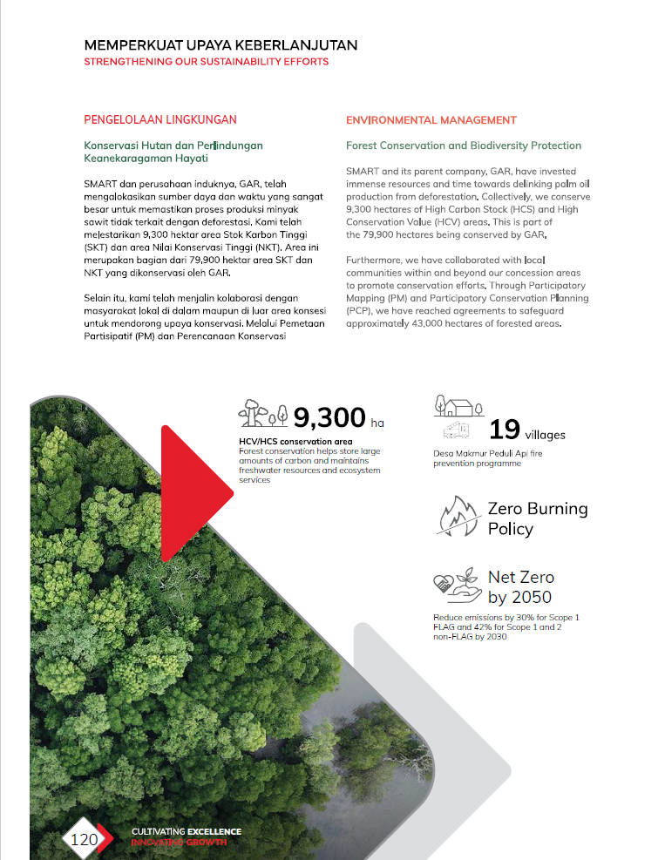
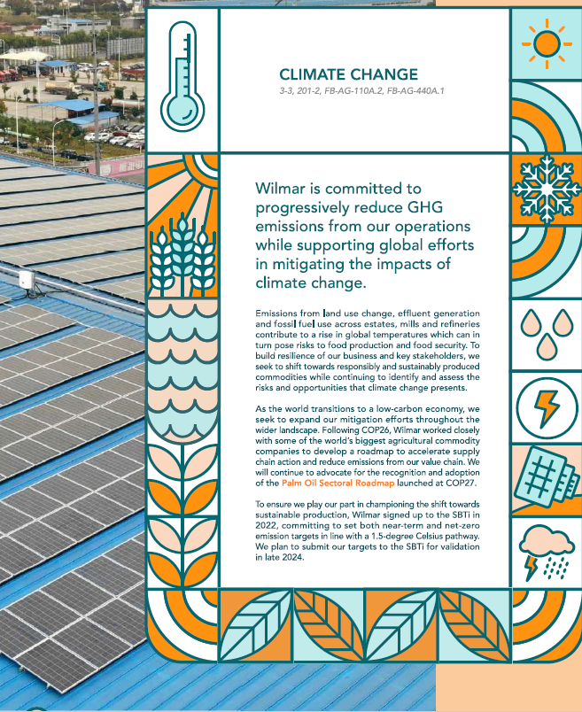
Methods: Move-based CGA with researcher lead
Manual inductive coding was organized in Excel and verified through data checking.
6
CSR reports in English, companies are located in Sumatra Island
Collect reports
Segment units
Code moves
6 oil palm companies
text + visual
topic / step / purpose(AI assistance and manual )
703
coded rhetorical units
Interpret CGA
Verify
200
visual / multimodal units
discourse + function
research assistant check
Unit of analysis
• Heading • clause • paragraph • table • chart • diagram • photo • infographic
CSR Report : Environment Section
CONAPLIN 2026 • Critical Genre Analysis of CSR Environmental Reporting
6
Notes:
Explain manual coding positively: because move identification requires interpreting communicative purpose. Excel was used as a coding matrix and the research assistant verified the categories.

Slide 8
Analytical coding logic
The coding separated what is discussed from what the text is doing.
Topic
Move
Step
Discourse / CGA
What is being discussed?
fire, carbon, biodiversity, water
What is the text doing?
commit, assess, act, report
How is the move realized?
hotspot monitoring, emission data
What meaning and function are constructed?
legitimacy, accountability, trust
Example: fire prevention
A single topic can be realized through several moves: commitment → monitoring → action → stakeholder engagement → performance.
CONAPLIN 2026 • Critical Genre Analysis of CSR Environmental Reporting
7
Notes:
This is important for genre analysis. Topic is not move. One paragraph may contain several rhetorical units and each unit is coded according to communicative function.

Slide 9
Topics in the environment sections Move frequency was calculated from coded rhetorical units, not from paragraphs.
Carbon emission / climate change
Renewable energy / clean energy
Biodiversity conservation
Forest conservation / no deforestation
Peatland management
Fire prevention
Water management
Waste management
Environmental compliance
Environmental certification
Community-based environmental program
CONAPLIN 2026 • Critical Genre Analysis of CSR Environmental Reporting
9
Notes:
The distribution shows that reports emphasize strategies/actions, performance reporting, and assessment/monitoring. This supports the idea that environmental responsibility is presented as measurable and manageable.

Slide 10
Finding 1: Move structure
The environmental sections show a recurring rhetorical organization.
M1
Introducing the environmental section
M2
Framing environmental commitment
M3
Establishing environmental credentials
M4
Explaining assessment and monitoring
M5
Describing environmental risks and issues
M6
Presenting environmental strategies/actions
M7
Reporting achievements and performance
M8
Emphasizing stakeholder engagement
M9
Projecting future commitments
Genre pattern
orientation → commitment → validation → assessment → risk → action → evidence → engagement → future projection
CONAPLIN 2026 • Critical Genre Analysis of CSR Environmental Reporting
8
Notes:
Introduce the nine moves. Explain that they are not simply topics, but functional rhetorical units.

Slide 11
Finding 1: Core moves are action, performance, and assessment
Move frequency was calculated from coded rhetorical units, not from paragraphs.
Key pattern
M7 Performance (157)
M6 Actions (155)
M4 Assessment (121)
All 9 moves are obligatory
Companies prioritize showing M7.Explaining achievement & Performance -what they do M6. Presenting strategies -Actions : how they measure it
M4. Explaining Assessment & monitoring: what results they can display.
CONAPLIN 2026 • Critical Genre Analysis of CSR Environmental Reporting
9
Notes:
The distribution shows that reports emphasize strategies/actions, performance reporting, and assessment/monitoring. This supports the idea that environmental responsibility is presented as measurable and manageable.

Slide 12
Finding 2: Communicative purposes by move
The same environmental section combines information, accountability, and strategic positioning.
Move
Purposes
CGA
M2 Commitment
Declare values and principle
The company aims to reduce emissions intensity and improve climate mitigation and adaptation practices.
Responsible identity
M3 Credentials
Show standard , certification, compliance
The company adopts a strict zero-tolerance policy prohibiting logging, burning, poaching, injuring, or killing of RTE, endemic, or beneficial species.
Institutional legitimacy
M4 Assessment
Explain monitoring and measurement
The report refers to BOD and COD indicators as part of wastewater assessment.
Technical control
M6 Actions
Describe strategies and implementation
Renewable energy from palm oil operations is leveraged for crop operations, including rubber, sugar, tea, and cocoa facilities.
Problem-solving capacity
M7 Performance
Report indicators, achievements, results
By the end of 2024, PT HPIP had planted 750 new trees and regenerated 11.6 km of riverbank habitat.
Accountability evidence
M8 Engagement
Show community and stakeholder involvement
From September 2023 to March 2024, the company participated in a national inventory exercise conducted by the Ministry of Forestry.
Social legitimacy
M9 Future
State targets and roadmap
The table states a 3.5% reduction target for water intensity across oil palm operations and refineries by 2025 based on the 2020 baseline.
Long-term trust
Purpose analysis clarifies why a move appears and how it contributes to the larger construction of corporate environmental responsibility.
CONAPLIN 2026 • Critical Genre Analysis of CSR Environmental Reporting
11
Notes:
Use this matrix to show how the moves can be explained as communicative purposes and then linked to CGA interpretation.

Slide 13
Finding 2: Topics are realized through multiple moves
Environmental topics are not moves; they are rhetorically managed through different move functions.
Example: fire prevention
M2
M4
M6
M8
M7
Commit
Monitor
Act
Engage
Report
Interpretation
Sensitive environmental topics such as fire, emissions, peat, and biodiversity are constructed through layered moves: commitment, monitoring, action, evidence, and stakeholder legitimacy.
CONAPLIN 2026 • Critical Genre Analysis of CSR Environmental Reporting
12
Notes:
Explain topic vs move. The same topic can be coded under different moves depending on what the text is doing.

Slide 14
Finding 3: Multimodality supports the genre work
Visual units are used not only as decoration, but as rhetorical evidence.
200 visual/multimodal units coded
Tables & charts
Accountability
performance evidence
Diagrams & maps
Technical control
assessment process
Photos
Stakeholder
participation and action
Infographics
Future targets
and strategic framing
Visual data help turn environmental responsibility into something visible, measurable, and credible.
CONAPLIN 2026 • Critical Genre Analysis of CSR Environmental Reporting
13
Notes:
The chart shows visual units concentrated in performance, assessment, and action moves. This supports the argument that visual resources are part of the genre.

Slide 15

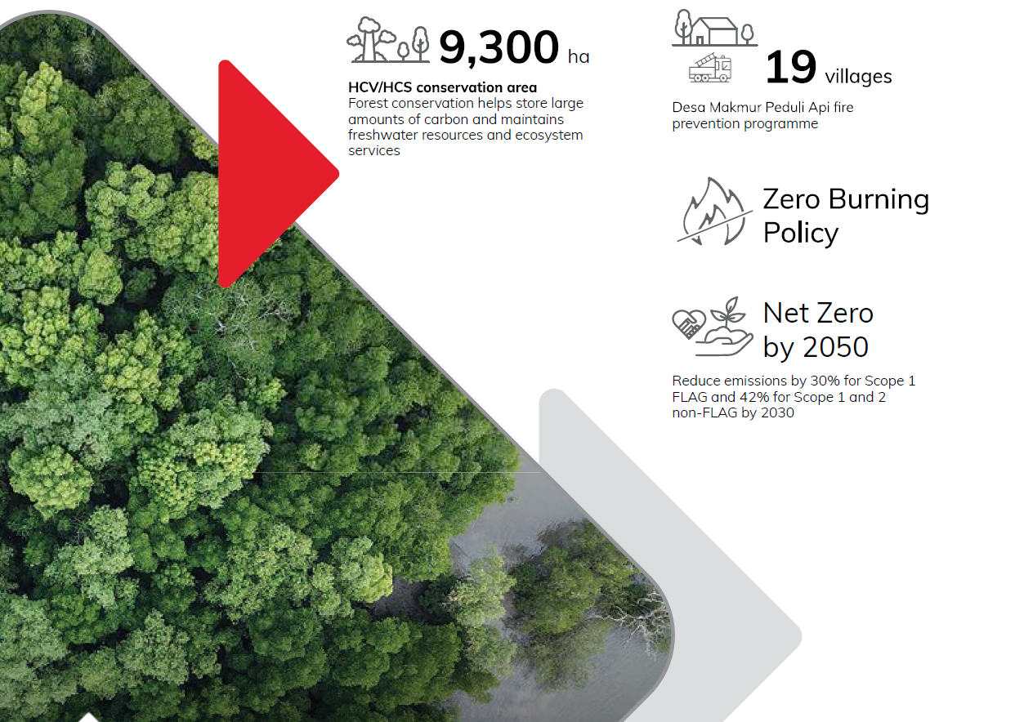
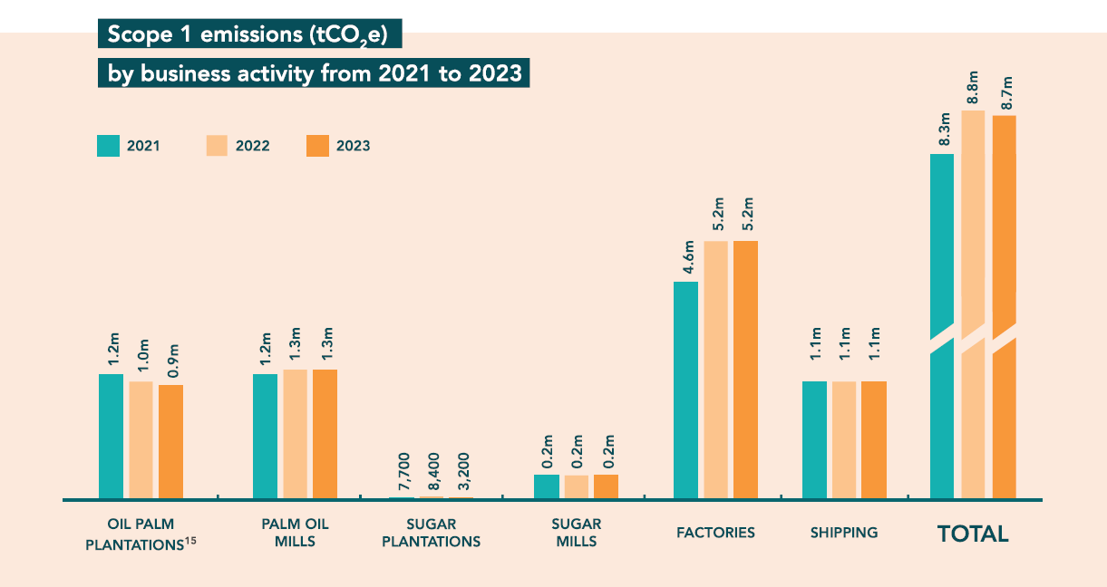
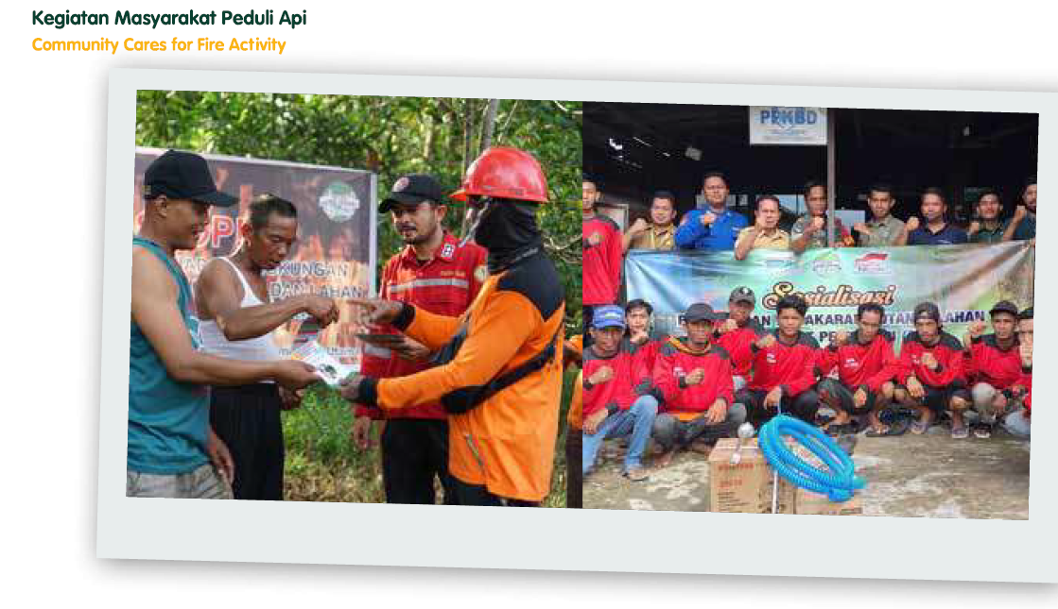
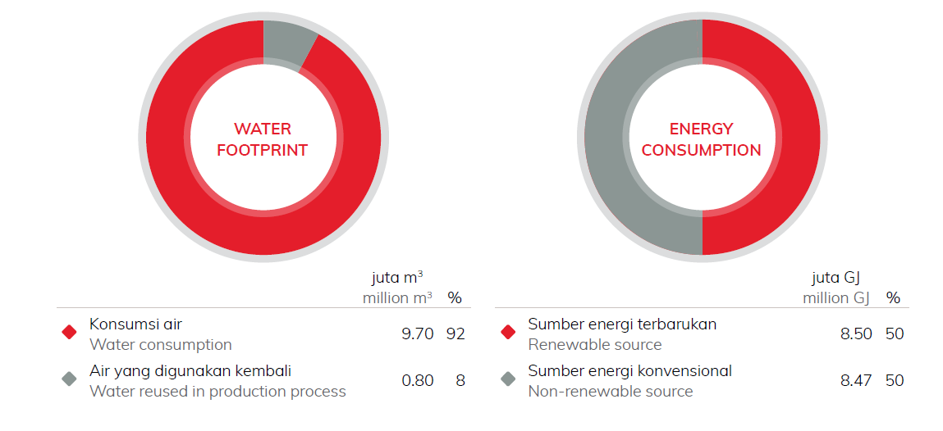
Finding 3: Multimodality supports the genre work
Visual data: photos, diagram, graphic, infographic turn environmental responsibility into something visible, measurable, and credible.
CONAPLIN 2026 • Critical Genre Analysis of CSR Environmental Reporting
13
Notes:
The chart shows visual units concentrated in performance, assessment, and action moves. This supports the argument that visual resources are part of the genre.

Slide 16
Discussion: CSR environmental sections as strategic professional genres
Move structure, communicative purpose, and multimodality work together.
The environmental section of CSR report has been formed through moves, evidence, and visual resources.
Responsibility
commitment + future targets
companies present environmental responsibility as a corporate value
Legitimacy
credentials + standards
standards, certification, and compliance validate corporate claims
Accountability
data + performance
tables and indicators present responsibility as measurable evidence
Technical control
assessment + monitoring
risk is framed as manageable through systems and procedures
Stakeholder trust
engagement + photos
community and partnership narratives build social legitimacy
Critical genre interpretation
The reports make environmental responsibility appear in structure, provide evidence, perform professionally , and show responsibility.
CONAPLIN 2026 • Critical Genre Analysis of CSR Environmental Reporting
14
Notes:
Discussion slide: tie together rhetorical moves, communicative purposes, and multimodal evidence as the construction of corporate environmental responsibility.

Slide 17
Conclusion
What the study contributes to genre analysis and CSR discourse.
1
CSR environmental sections show a recurring nine-move structure.
2
The strongest pattern is action + performance + assessment, suggesting responsibility is constructed as measurable and manageable.
3
Visual and multimodal resources are central rhetorical evidence, especially in performance reporting and assessment.
4
The study extends Critical Genre Analysis to CSR environmental reporting in a high-scrutiny industry. The study will move forward to the critical genre study and extend to the ethnographic study.
Thank you
CONAPLIN 2026 • Critical Genre Analysis of CSR Environmental Reporting
15
Notes:
End by reinforcing the contribution: not only a list of moves, but an explanation of how corporate environmental responsibility is built through genre and multimodality.

Slide 18
References
Bhatia, V. K. (1993). Analysing Genre: Language Use in Professional Settings. London: Longman.
Bhatia, V. K. (2004). Worlds of Written Discourse. New YorK : Continuum.
Bhatia, A. (2013). International genre, local flavour: Analysis of PetroChina's Corporate and Social Responsibility Report. Revista Signos, 46(83), 307–331.
Bhatia, V. K. (2017). Critical Genre Analysis: Investigating Interdiscursive Performance in Professional Practice.London: Routledge.
Hyland, K. (2005). Metadiscourse. Bloomsbury Publishing.
Ismaeel, M., & Zakaria, Z. (2024). CSR reporting in Arab countries: the emergence of three genres. Journal of Accounting & Organizational Change, 20(1), 112–129.
Kress, G., & van Leeuwen, T. (2006). Reading Images: The Grammar of Visual Design.
Othman, R., & Ameer, R. (2010). Environmental disclosures of palm oil plantation companies in Malaysia: a tool for stakeholder engagement. Corporate Social Responsibility and Environmental Management, 17(1), 52–62
Swales, J. M. (1990). Genre Analysis: English in Academic and Research Settings.Cambridge: Cambridge university Press.
Yu, D., & Bondi, M. (2017). The Generic Structure of CSR Reports in Italian, Chinese, and English: A Corpus-Based Analysis. IEEE Transactions on Professional Communication, 60(3), 273–291
CONAPLIN 2026 • Critical Genre Analysis of CSR Environmental Reporting
16
Notes:
Reference slide can be shown quickly or kept as backup.

