Slide 1
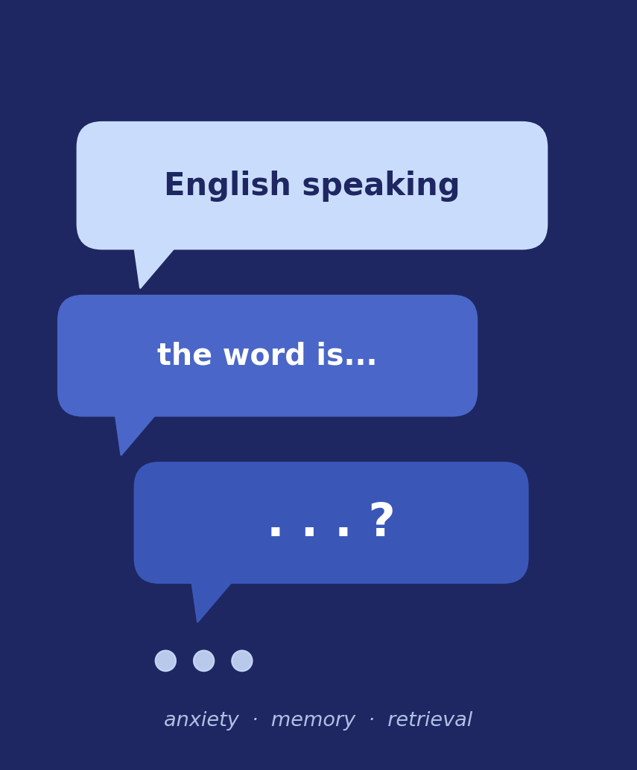
Foreign Language Anxiety and Lexical Retrieval Failure in EFL Speaking
A Thematic Review with a Focus on the Indonesian Context
Desi Purnama Sari · Jatmika Nurhadi
Universitas Pendidikan Indonesia

Slide 2

Abstract — Core Message
Across 43 empirical studies (2000–2026), FLA negatively relates to lexical retrieval—primarily by consuming working memory and attention—showing as increased pausing and slower processing rather than loss of knowledge. Indonesian factors (limited vocabulary, teacher-centred teaching, scarce speaking practice) amplify the effect.
Notes:
First, the core message. Across 43 empirical studies, from 2000 to 2026, we found a clear pattern. Foreign language anxiety has a negative relationship with lexical retrieval. It works mainly by using up working memory and attention. It shows as more pausing and slower processing. It is not a loss of knowledge. In Indonesia, factors like limited vocabulary, teacher-centred teaching, and little speaking practice make the effect stronger.
2

Slide 3
Background: Why This Matters
Speaking English is the hardest skill for many Indonesian learners.
When we feel anxious, we often cannot find a word we already know.
This word-finding problem is a clear, visible sign of anxiety in speech.
Yet anxiety and word-retrieval have mostly been studied separately.
This review brings the two together — for the Indonesian EFL context.
FLA & Lexical Retrieval Failure in Indonesian EFL Speaking
2

Slide 4
Two Key Concepts
Foreign Language Anxiety (FLA)
Lexical Retrieval Failure
The worry and tension a learner feels when using a foreign language.
It is tied to the situation — especially speaking, where mistakes are public.
The moment a speaker cannot produce a word they already know.
We hear it as pauses, hesitations, and self-correction during speech.
FLA & Lexical Retrieval Failure in Indonesian EFL Speaking
3

Slide 5
Aim & Research Questions
Aim: to synthesise how anxiety relates to word-retrieval failure in EFL speaking, and how the Indonesian context shapes it.
Q1
How does anxiety influence lexical retrieval failure in speaking?
Q2
Through which cognitive mechanisms and behavioural signs?
Q3
How is it shaped by the Indonesian and wider Asian context?
Q4
Which teaching responses show the most promise?
FLA & Lexical Retrieval Failure in Indonesian EFL Speaking
4

Slide 6





Theoretical Framework
FLA Construct
Horwitz et al.'s FLCAS—situation-specific anxiety vs trait anxiety.
Cognitive-Interference
Attentional Control & Cognitive Load theories: anxiety uses limited working memory /attention.
Speech Production
Levelt’s stages: conceptualization → formulation → articulation; locus of interference debated.
We plan, choose words, then speak; anxiety can disturb this flow
Cultural Lens
Individualism–collectivism explains higher classroom anxiety in collectivist contexts.
Collectivist norms can raise anxiety about public mistakes

Slide 7
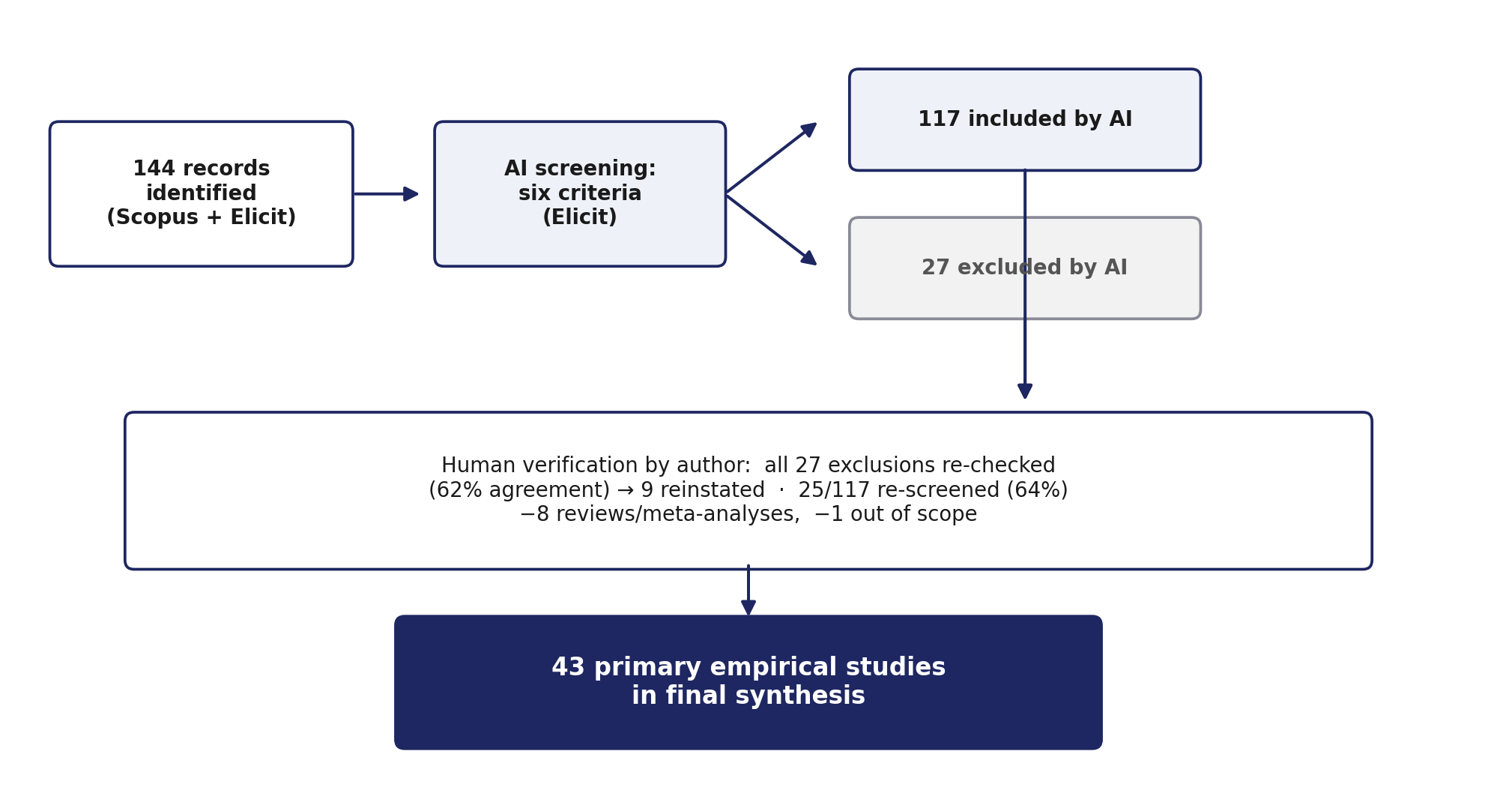
Method Snapshot
Design: thematic synthesis (not a meta-analysis)
Source: Scopus + AI-assisted discovery (Elicit)
Screening: six inclusion criteria
Verification: the author checked AI decisions by hand
Period: 2000–2026
FLA & Lexical Retrieval Failure in Indonesian EFL Speaking
6

Slide 8
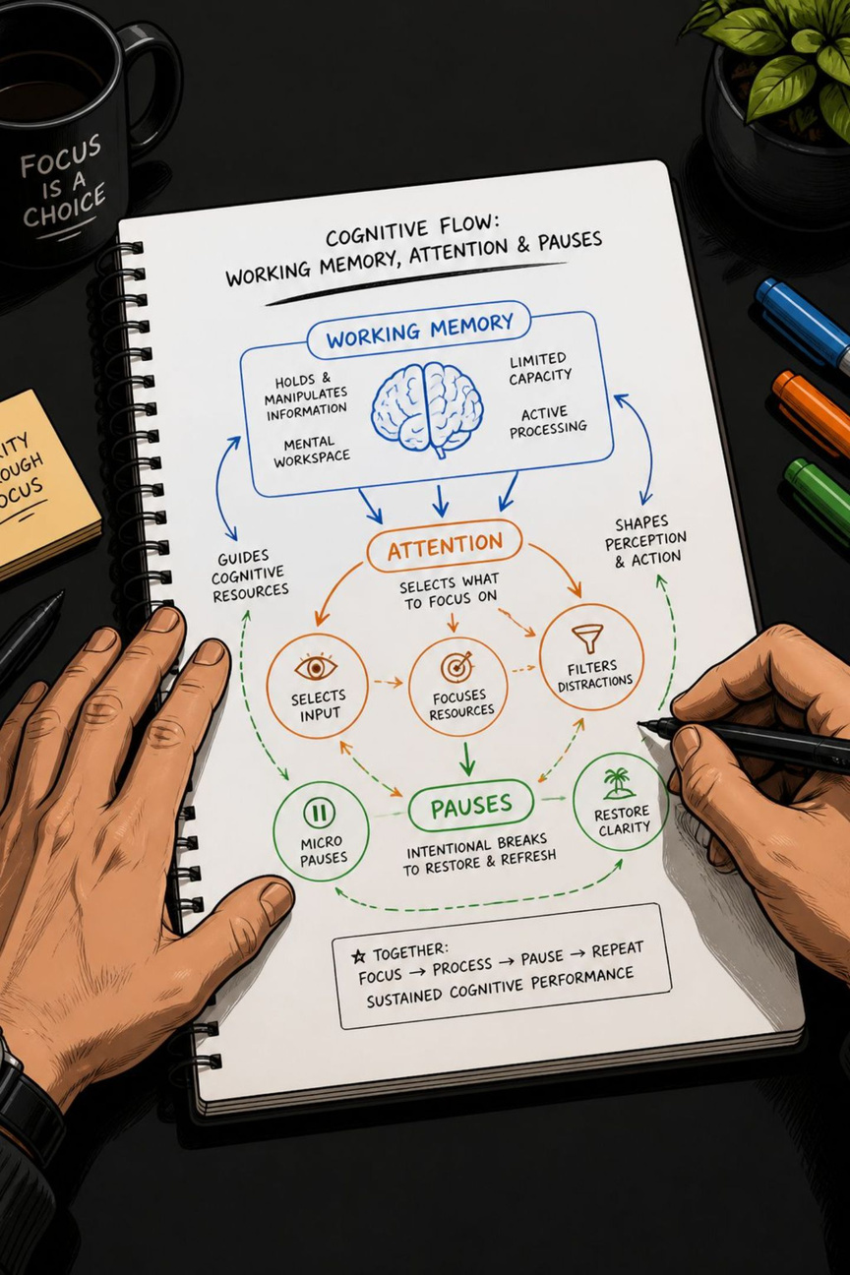


Finding 1 — Cognitive Mechanisms
Anxiety uses up the working memory and attention that fast word access needs.
Every study reporting direction found a negative relationship: higher FLA → poorer/slower lexical retrieval. Main mechanism: anxiety consumes working memory and attention, reducing processing speed while accuracy often remains intact—consistent with processing-efficiency accounts.
Experimental evidence shows slower reaction times without accuracy loss, indicating interference with speed of access.

Slide 9

Finding 2 — Behavioural Signs & Task Effects
Disfluency
Task Sensitivity
More filled/silent pauses and slower speech rate linked to anxiety.
Effects vary by task complexity, spontaneity, and evaluative pressure; anxiety explains notable variance in breakdown fluency.
Dynamic Two-way Link
Awareness of retrieval failure spikes anxiety, creating momentary feedback loops.

Slide 10
Signs & the Role of Task
The mechanism is cognitive; the visible sign is disfluency.
More pauses
More self-repair
Higher anxiety leads to more filled and silent pauses, and slower speech.
Anxious learners stop and correct themselves more often.
Task matters
A two-way loop
Hard, spontaneous, and graded tasks make retrieval failures worse.
Noticing the failure raises anxiety, which worsens the next attempt.
FLA & Lexical Retrieval Failure in Indonesian EFL Speaking
8

Slide 11
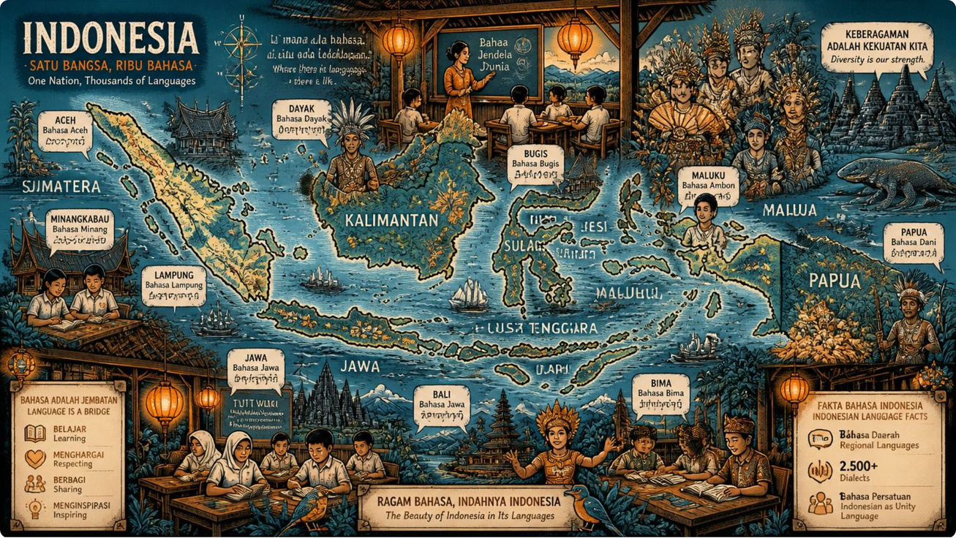
Finding 3 — Indonesian & Asian Contexts
Recurring sources: limited productive vocabulary, low confidence, fear of negative evaluation, teacher-centred/grammar-focused instruction, and limited exposure to English. Multilingual environment means English is often the least-practised layer.
Distinction matters: some learners face retrieval-interference (words present but blocked) while others have genuine skills deficits—each needs different teaching responses.

Slide 12
The Indonesian Context
In Indonesia, these factors recur as both cause and effect of speaking anxiety:
Limited vocabulary
Low self-confidence
Fear of negative evaluation
Little speaking practice
Cultural amplifier: in collectivist classrooms, a public mistake clashes with social harmony, so anxiety rises across many Asian settings.
English is often the least-practised language in a learner's daily multilingual life.
FLA & Lexical Retrieval Failure in Indonesian EFL Speaking
9

Slide 13
Finding 3b — Two Learner Profiles
An important idea from Woodrow: not every learner needs the same help.
Blocked by anxiety
Genuine skills gap
These learners have the words, but anxiety blocks access in the moment of speaking.
These learners have a truly thin vocabulary base that needs building.
Needs: lower anxiety, safe speaking practice
Needs: vocabulary building and exposure
FLA & Lexical Retrieval Failure in Indonesian EFL Speaking
10

Slide 14



Finding 4 — Interventions
Technology-Based
Task-Based & Socio-affective
Strategy Teaching
CALL, digital storytelling, video and song practice reduce social-evaluative pressure and improve vocabulary, pronunciation, fluency.
Teach diverse coping strategies; help learners move beyond narrow repetitive tactics.
Task-based teaching and socio-affective methods raise confidence and speaking proficiency.
Infrastructure and digital literacy limit widespread adoption of technology solutions in parts of Indonesia.

Slide 15
What Helps
✓
Lower the pressure
Technology-based practice (apps, digital media) lets learners speak with less peer judgement.
✓
Structured speaking
Task-based teaching builds both confidence and speaking skill.
✓
Socio-affective support
A supportive classroom and positive strategies reduce anxiety.
Caveat: technology depends on internet access and digital skills, which are still uneven across Indonesia.
FLA & Lexical Retrieval Failure in Indonesian EFL Speaking
11

Slide 16
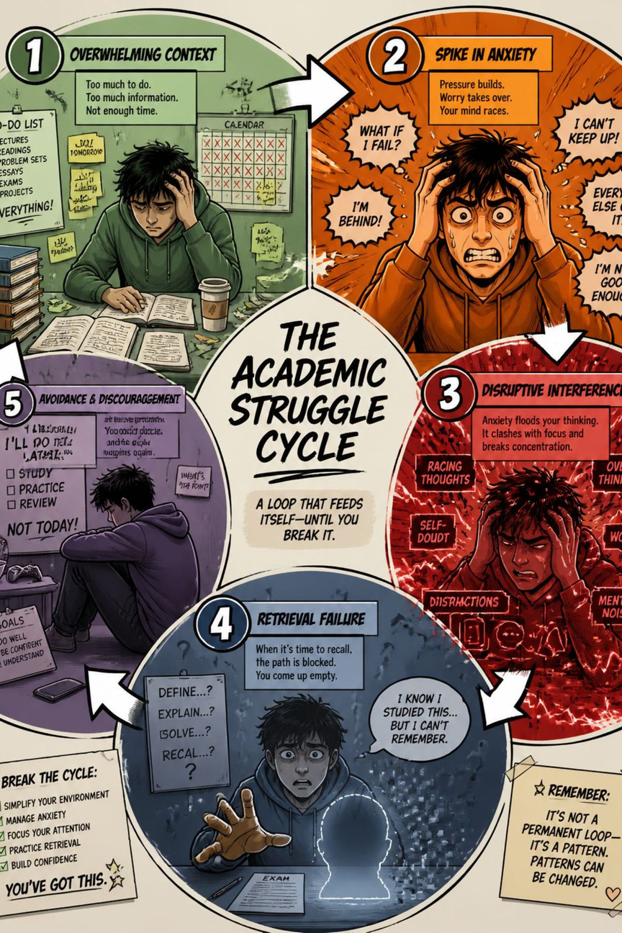

Integrative Model & Limitations
Contextual Conditions
Weak Productive Vocabulary
Working Memory Load → Retrieval Failure
Evaluative Speaking → FLA
Limits: few studies measure FLA and lexical retrieval together; locus of disturbance (conceptualization vs formulation) is unresolved for Indonesian–English pairings; reliance on self-report scales constrains process-level claims.

Slide 17
The Key Gap & Limitations
Very few studies measure anxiety and lexical retrieval in the same design.
The link is mostly inferred from fluency measures and self-report scales.
The exact point where anxiety disturbs speech is still debated.
Direct evidence within the Indonesian context remains scarce.
This gap is our main message for future research: measure the two together, directly, in natural Indonesian EFL speaking.
FLA & Lexical Retrieval Failure in Indonesian EFL Speaking
13

Slide 18

Conclusion & Next Steps
Key Conclusion
Research Priorities
FLA consistently harms lexical retrieval speed/fluency by consuming WM/attention; manifested as pauses and slower processing rather than word loss.
Design studies that measure FLA and lexical retrieval together in natural speaking tasks; test conceptualization vs formulation specifically for Indonesian–English.
Implications
For Teachers
For Researchers
Combine a low-anxiety classroom with structured, regular speaking practice — and tell the two learner profiles apart.
Measure lexical retrieval failure directly, in natural speaking tasks, within the Indonesian EFL context.
Keywords: foreign language anxiety, lexical retrieval failure, EFL speaking, Indonesian EFL, working memory, thematic synthesis, cognitive interference.

Slide 19
Thank You
I warmly welcome your questions and suggestions.
Desi Purnama Sari · Jatmika Nurhadi · Universitas Pendidikan Indonesia

