Slide 1




CONAPLIN-19
Exploring Digital Multimodal Resources for Autonomous EFL Learning: Students’ Perceptions of Songs and Poems from LearnEnglish Kids
Presented by Nadhira Puti Isladara
August 10th, 2026

Slide 2


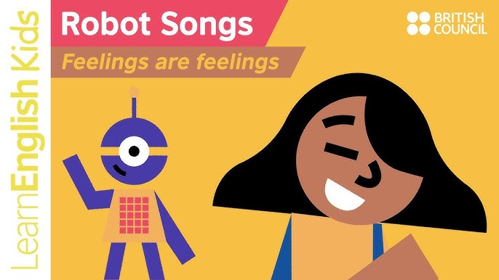
BACKGROUND
  Traditional EFL instruction can reduce engagement.
  Digital multimodal resources may support motivation and autonomous learning.
  Research compares songs and poems on LearnEnglish Kids.

Slide 3

RESEARCH GAP & OBJECTIVES
Few studies compare digital songs vs poems.
Gap
Objective
Investigate students’ perceptions and motivational impact.

Slide 4
METHODOLOGY
Instruments: 24-item questionnaire + interviews (7 students)
Design: Descriptive mixed methods
Participants: 65 Grade 7 EFL students
Platform: LearnEnglish Kids

Slide 5
RESULTS
Both songs and poems perceived positively.
Songs received higher overall mean (3.20) than poems (3.10).
Strongest advantage: Positive affect.

Slide 6
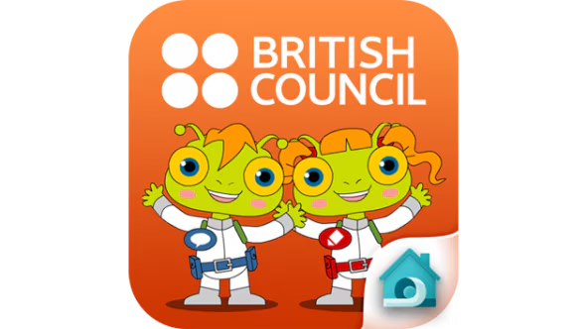
DISCUSSION
Songs’ audio, visuals and lyrics enhanced engagement (Sweller, 2011). .
Poems supported pronunciation and rhythm but were harder due to figurative language (Jeffries, 2022; Sharma, 2022).

Slide 7

CONCLUSION
  Both resources support autonomous learning motivation.
  Songs are more motivating and accessible.
  Teachers should sequence songs before poems.

Slide 8
LIMITATIONS & FUTURE RESEARCH
  Descriptive design and one school.
  Recommend experimental and longitudinal studies with broader populations.

Slide 9
CONAPLIN-19
THANK YOU

