Slide 1
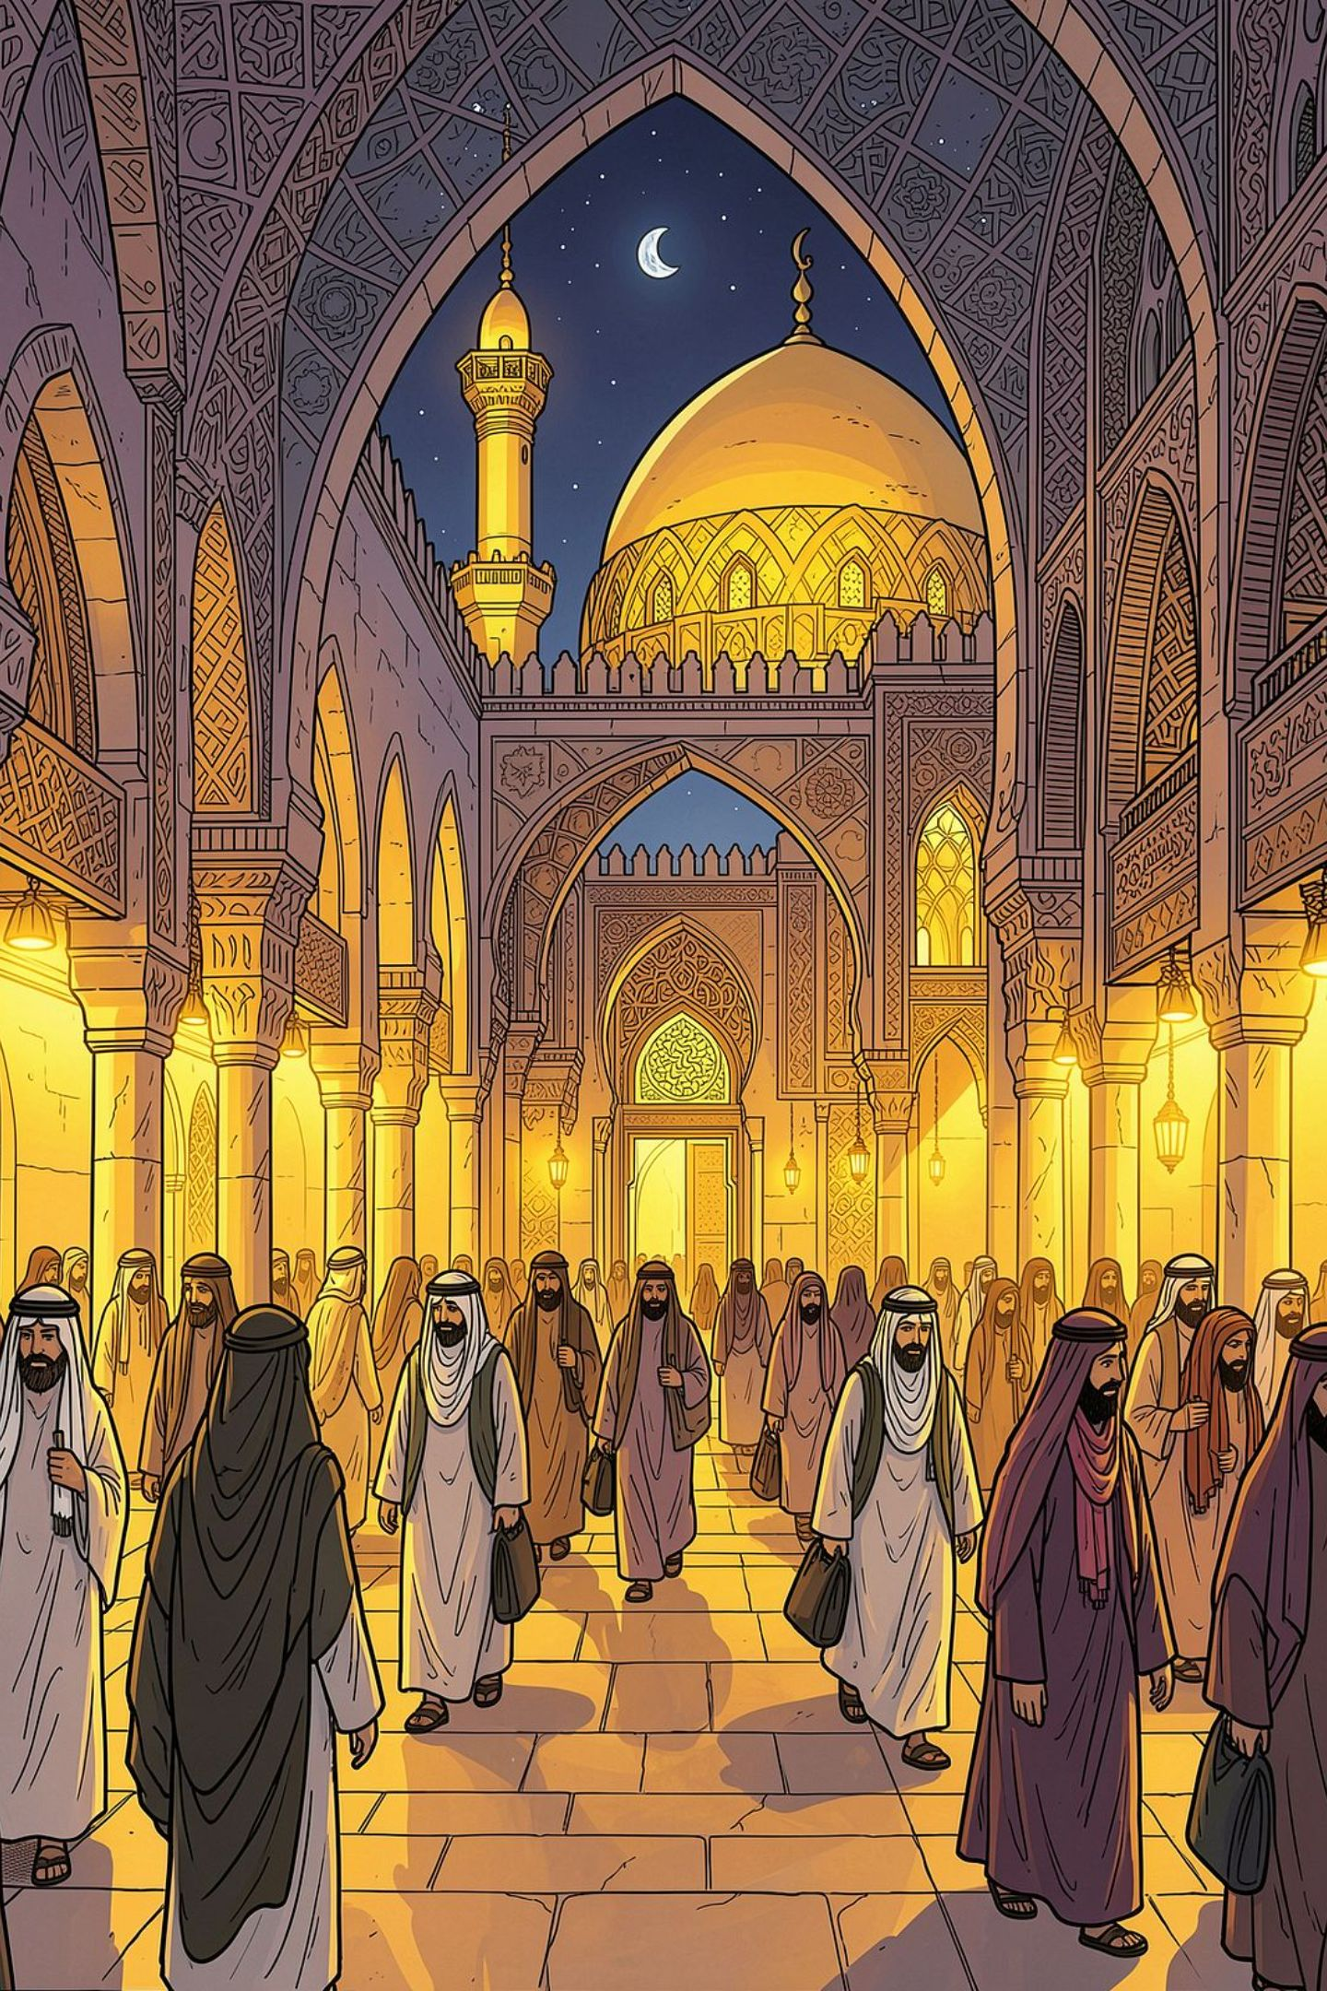
The Dominance of Bahasa Indonesia beyond Its Borders
A Sociolinguistic Study of the Haramain Pilgrimage Corridor
Wida Mulyanti, Adi Hidayat, Mahardhika Zifana, Mely Rizki Suryanita

Slide 2
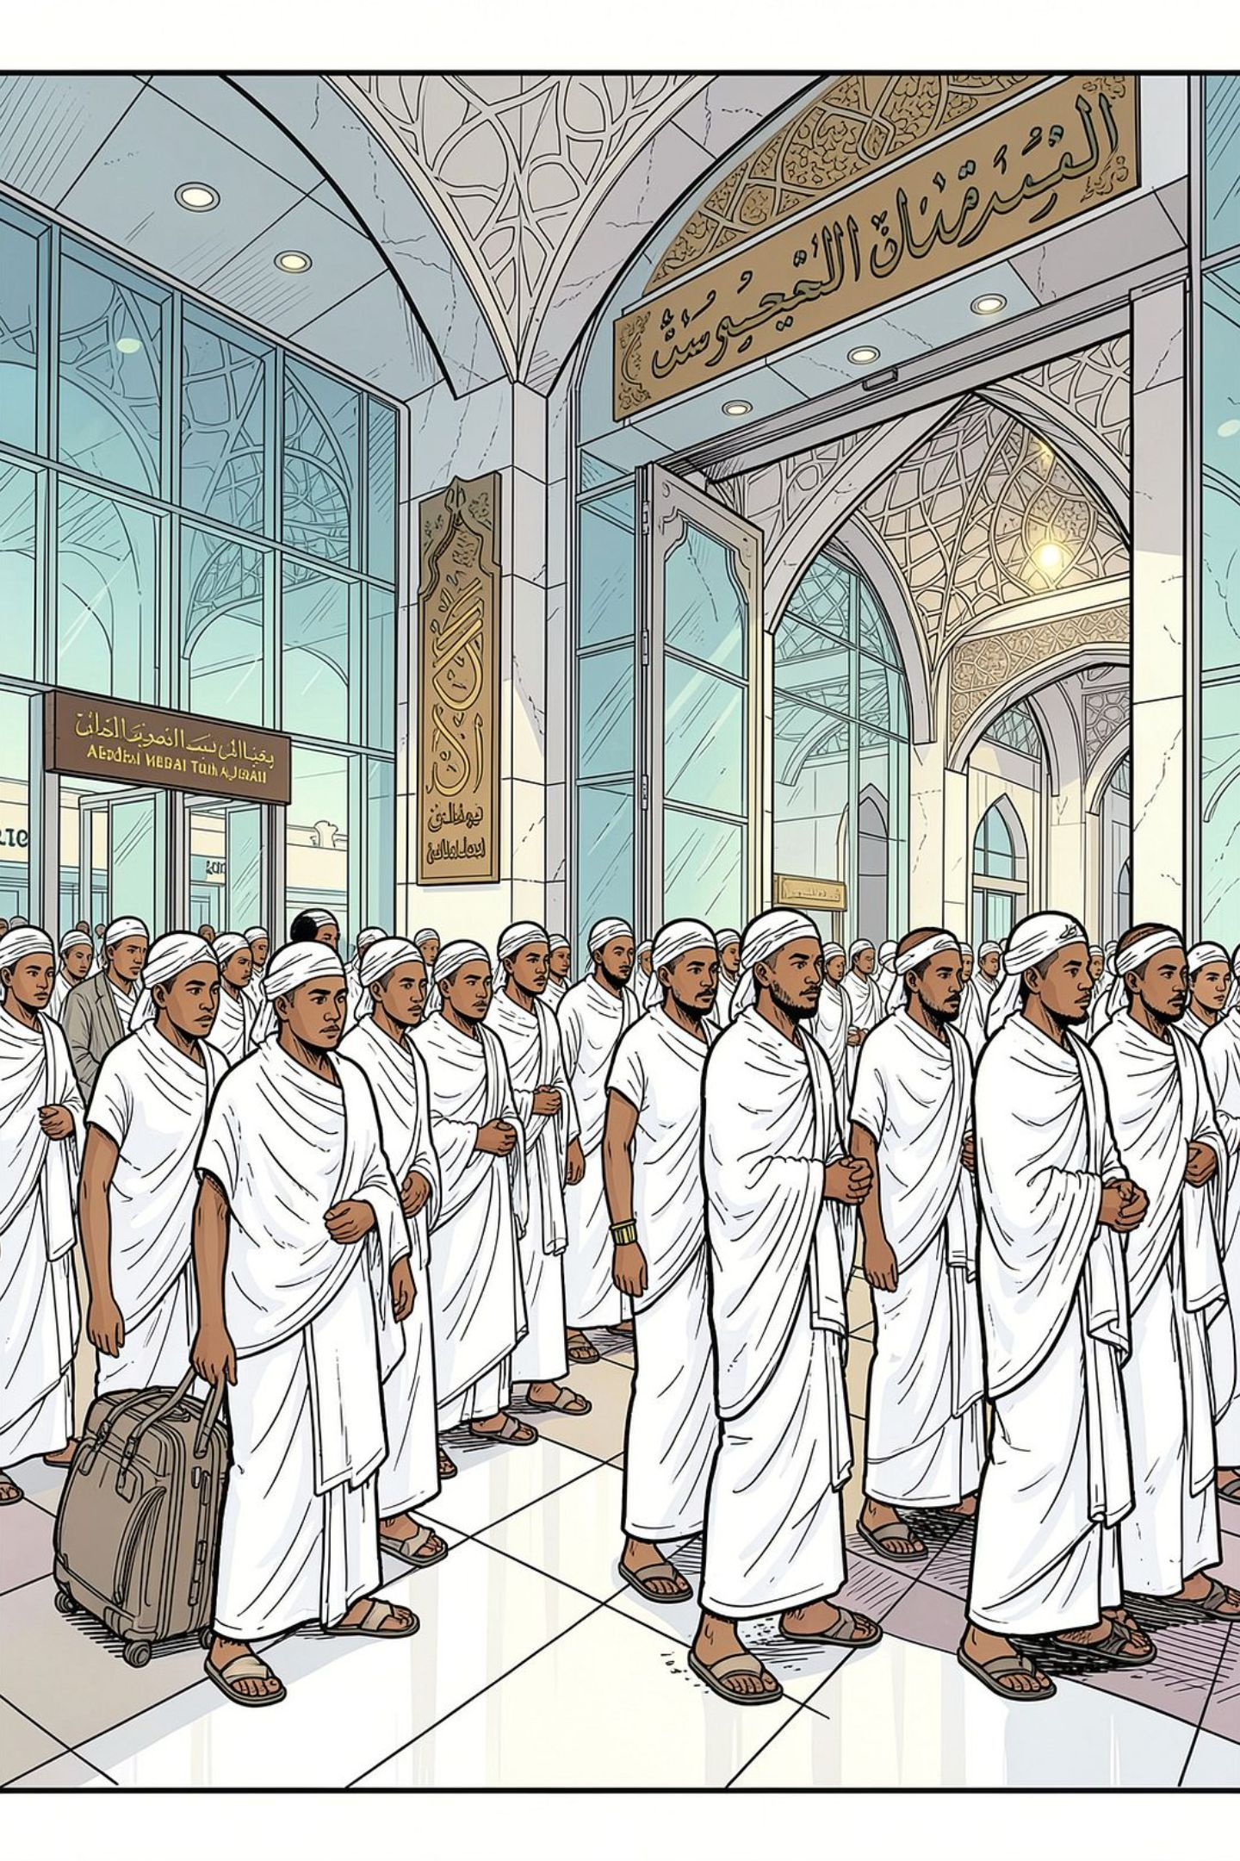


Background: Bahasa Indonesia on the World Stage
A Major Language, Little Studied
BI is one of the world's largest languages by speakers, yet rarely described as a language of wider communication beyond Indonesia and Malaysia.
UNESCO Recognition (2023)
BI was recognized as an official language of the UNESCO General Conference — a step toward internationalization, yet its transnational behavior remains underexamined.
The Corridor Setting
Millions of pilgrims from 180+ countries converge annually on Mecca and Medina, sustaining a permanent service economy of merchants and workers from South and Southeast Asia.

Slide 3


Millions of Visitors, One Small Area
Pilgrims from more than 180 countries converge annually on Mecca and Medina. Arabic saturates every visible surface — signs, scripture, prayer. Yet in the shops around the two mosques, the language of transaction is often not Arabic.
90%
Indonesian customers
of one restaurant worker's daily clientele
70%
Indonesian buyers
of one merchant's customer base

Slide 4
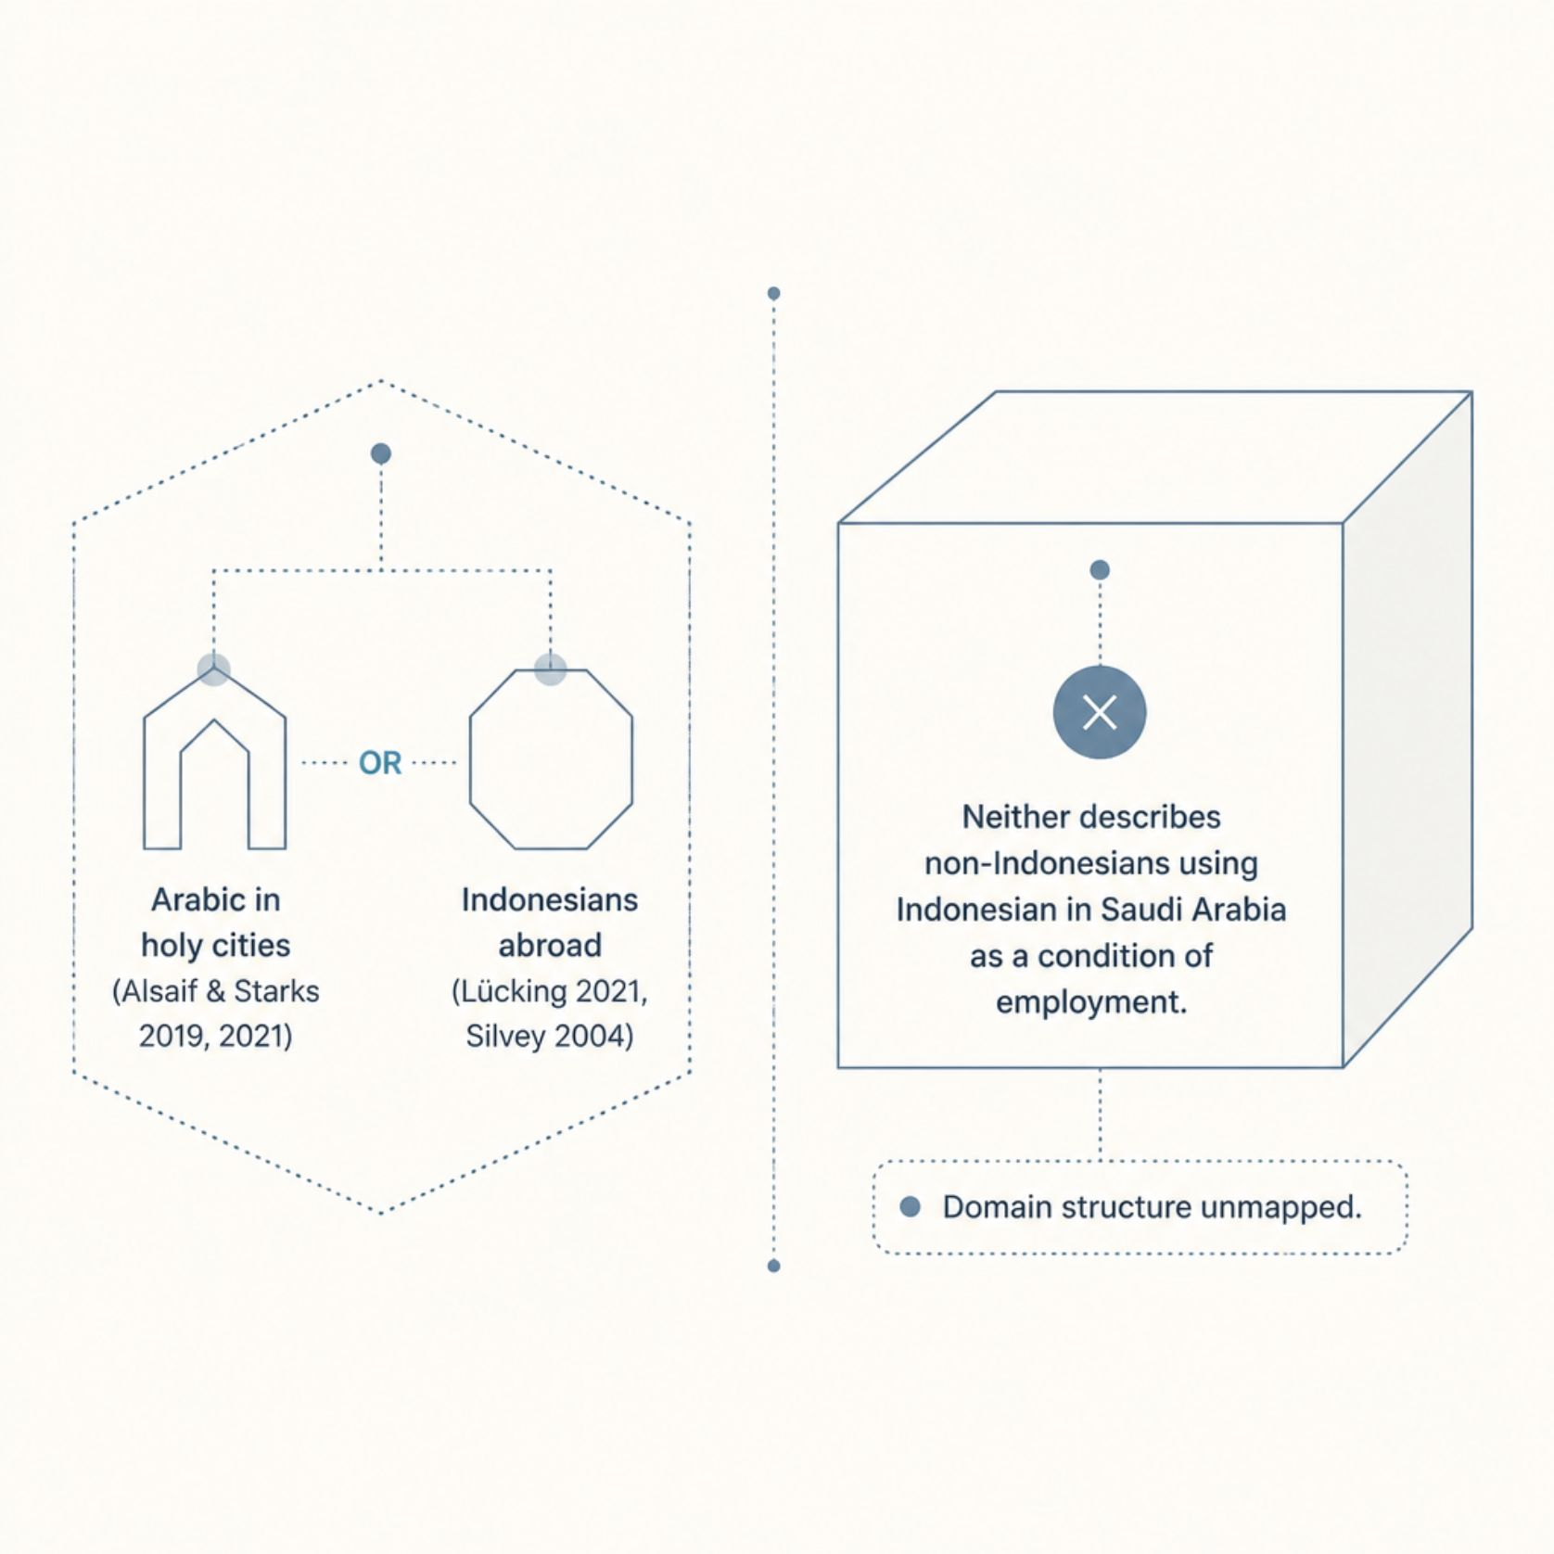

Research Gap & State of the Art
What the Literature Misses
Research on the holy cities describes Arabic; research on Indonesians abroad describes BI. Neither captures non-Indonesians using BI in Saudi Arabia as a condition of employment.
A recent call for a sociolinguistics of Islam argues the field has been overly Arabic-centered (Bhatt et al., 2025).

Slide 5
GAP AND QUESTIONS
Two literatures, one blind spot
A recent call for a sociolinguistics of Islam argues the field has been overly Arabic-centered (Bhatt et al., 2025).
What we know
Research on the holy cities describes Arabic. Research on BI abroad describes Indonesians in Malaysia and the Gulf.
What is missing
Non-Indonesians using Indonesian in Saudi Arabia, where it has no official standing and no institutional support.
Three questions — each concerning encounters in which Bahasa Indonesia is used
1
Which domains does Bahasa Indonesia occupy, and which languages hold those around it?
2
In which direction does accommodation run, and on what grounds?
3
How do participants describe and evaluate the languages available to them?
Notes:
~60s. The gap is simple to state. Two literatures exist and neither covers this case. Note the bounding clause on the questions: everything we claim concerns encounters where Indonesian was actually used — not the corridor as a whole.

Slide 6
METHOD
How we chose the fifteen recordings
56
39
15
interviews done in the field
recordings we could still play
where Indonesian carried the talk
The rule we used
One safeguard worth naming
We kept a recording only if Indonesian actually carried a conversation. A single word, a greeting or a number was not enough. Many of the recordings we left out do contain a word or two of Indonesian.
In interviews about language, the interviewer often supplies the opinion and the participant simply agrees. We separated the two. Only what a participant said first counts as their view.
Two of us screened and coded separately; the other two decided the cases we disagreed on. Ethics approval: 343/UN40.K/PT.01.01/2025.
Notes:
~65s. Spend the time on the right-hand card. That safeguard is the methodological contribution, and it changed our own results.

Slide 7
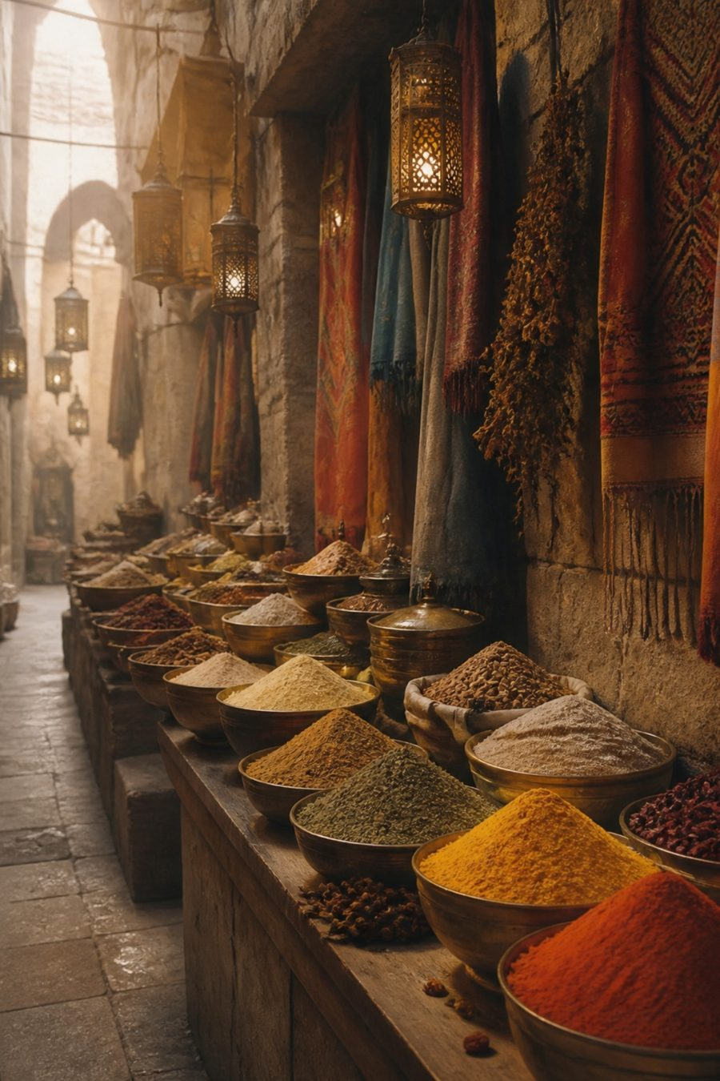
THE PEOPLE
More than half are not Indonesian
We chose by language, not by passport
A person qualified if Indonesian was used in the encounter. Nationality was never a condition. That single decision is what makes the corpus interesting.
Who they turned out to be
Seven Indonesians — two pilgrims and five workers. Eight others from Bangladesh, Yemen, Afghanistan, Myanmar and Saudi Arabia: merchants, shop staff, a street vendor.
So the corpus is not Indonesians carrying their language abroad. It is other people picking it up.
Notes:
~50s. This is the turn in the talk. If the audience only remembers one slide before the findings, make it this one.

Slide 8

Research Design & Methods
Qualitative, Synchronic Design
Semi-structured interviews, oral administration, 12–20 November 2025. Trilingual guide: Indonesian, English and Arabic on one sheet; administered orally so interviewers could switch language mid-item.
Setting
Masjid Nabawi (Medina), Masjidil Haram (Mecca), King Abdulaziz Airport (Jeddah).
Participants
Purposive sampling across 4 cells: Arab/non-Arab × resident/visitor. 15 qualifying recordings from 56 encounters.

Slide 9




Theoretical Framework
Domain Theory (Fishman, 1972)
Language Spread (Cooper, 1982)
Which language is used with whom, about what, and where — treating distribution as a social fact.
Spread driven by incentives, not language properties. Distinguishes planned vs. unplanned spread.
Accommodation Theory (Giles, 2016)
Linguistic Market (Bourdieu, 1991)
In a service economy, accommodation runs from seller to buyer; buyer's language gains value through purchasing power.
Language value is set by the market in which it is offered, not by intrinsic properties.

Slide 10

IDEAS WE USE
Four simple ideas from sociolinguistics
Domains
Language spread
People do not use one language everywhere. Each situation tends to attract its own language.
A language spreads when there is a reason to learn it — usually money, not policy.
Accommodation
Diglossia
When two people do not share a language, the one with more to gain adjusts.
Arabic is not one language. The Arabic of school and scripture differs from the Arabic of the street.
Together they predict what we then went out and checked: in a market, the seller learns the buyer’s language.
Notes:
~55s. Keep the definitions plain. The last line is the bridge into the findings.

Slide 11
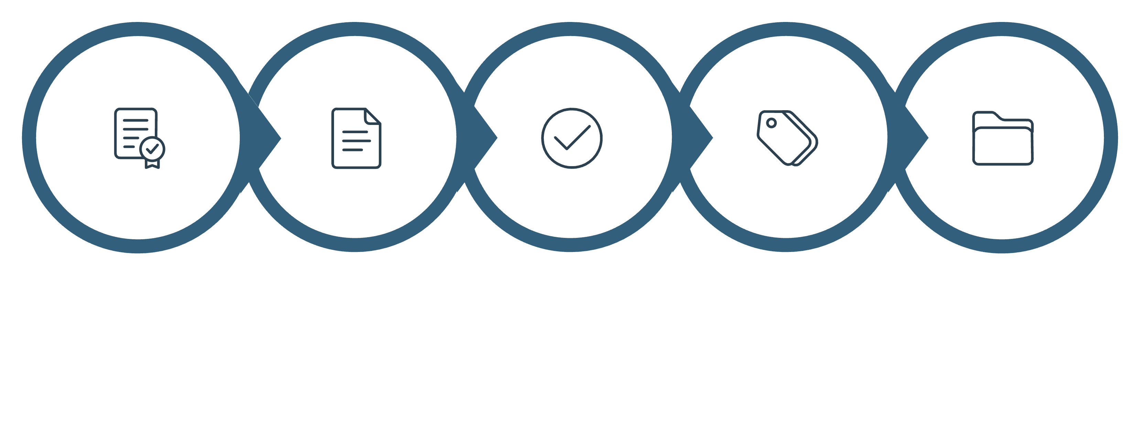
Data Analysis Procedure
Transcribe
Extract
Provenance
Code
Collate
The provenance check is the key methodological device: propositions introduced by interviewers and merely endorsed by participants are marked as ratified — not treated as participant belief. This materially changed the findings.

Slide 12

Findings: Domain Allocation
Domain
Language(s)
Key Participants
Key Distributional Finding
Of 8 non-Indonesian participants: 2 name BI as their most-used language in the corridor; 5 include it in their repertoire; 1 does not use it (P8). No non-Indonesian uses BI for worship.
Canonical prayer (salat)
Arabic
All
Personal supplication
Mother tongue / mixed
P1, P3, P4, P5, P10
BI occupies the largest number of domains of any language in the corridor apart from Arabic — including the domain where most waking hours are spent.
Commerce w/ Indonesian customers
Bahasa Indonesia
P4, P5, P6, P10, P12, P13
Peer interaction (Indonesian workers)
BI; regional languages
P3, P9, P14, P15
Non-Indonesian pilgrims
Arabic / English
P3, P15
Household / intimate talk
Regional languages
P1, P3, P9

Slide 13
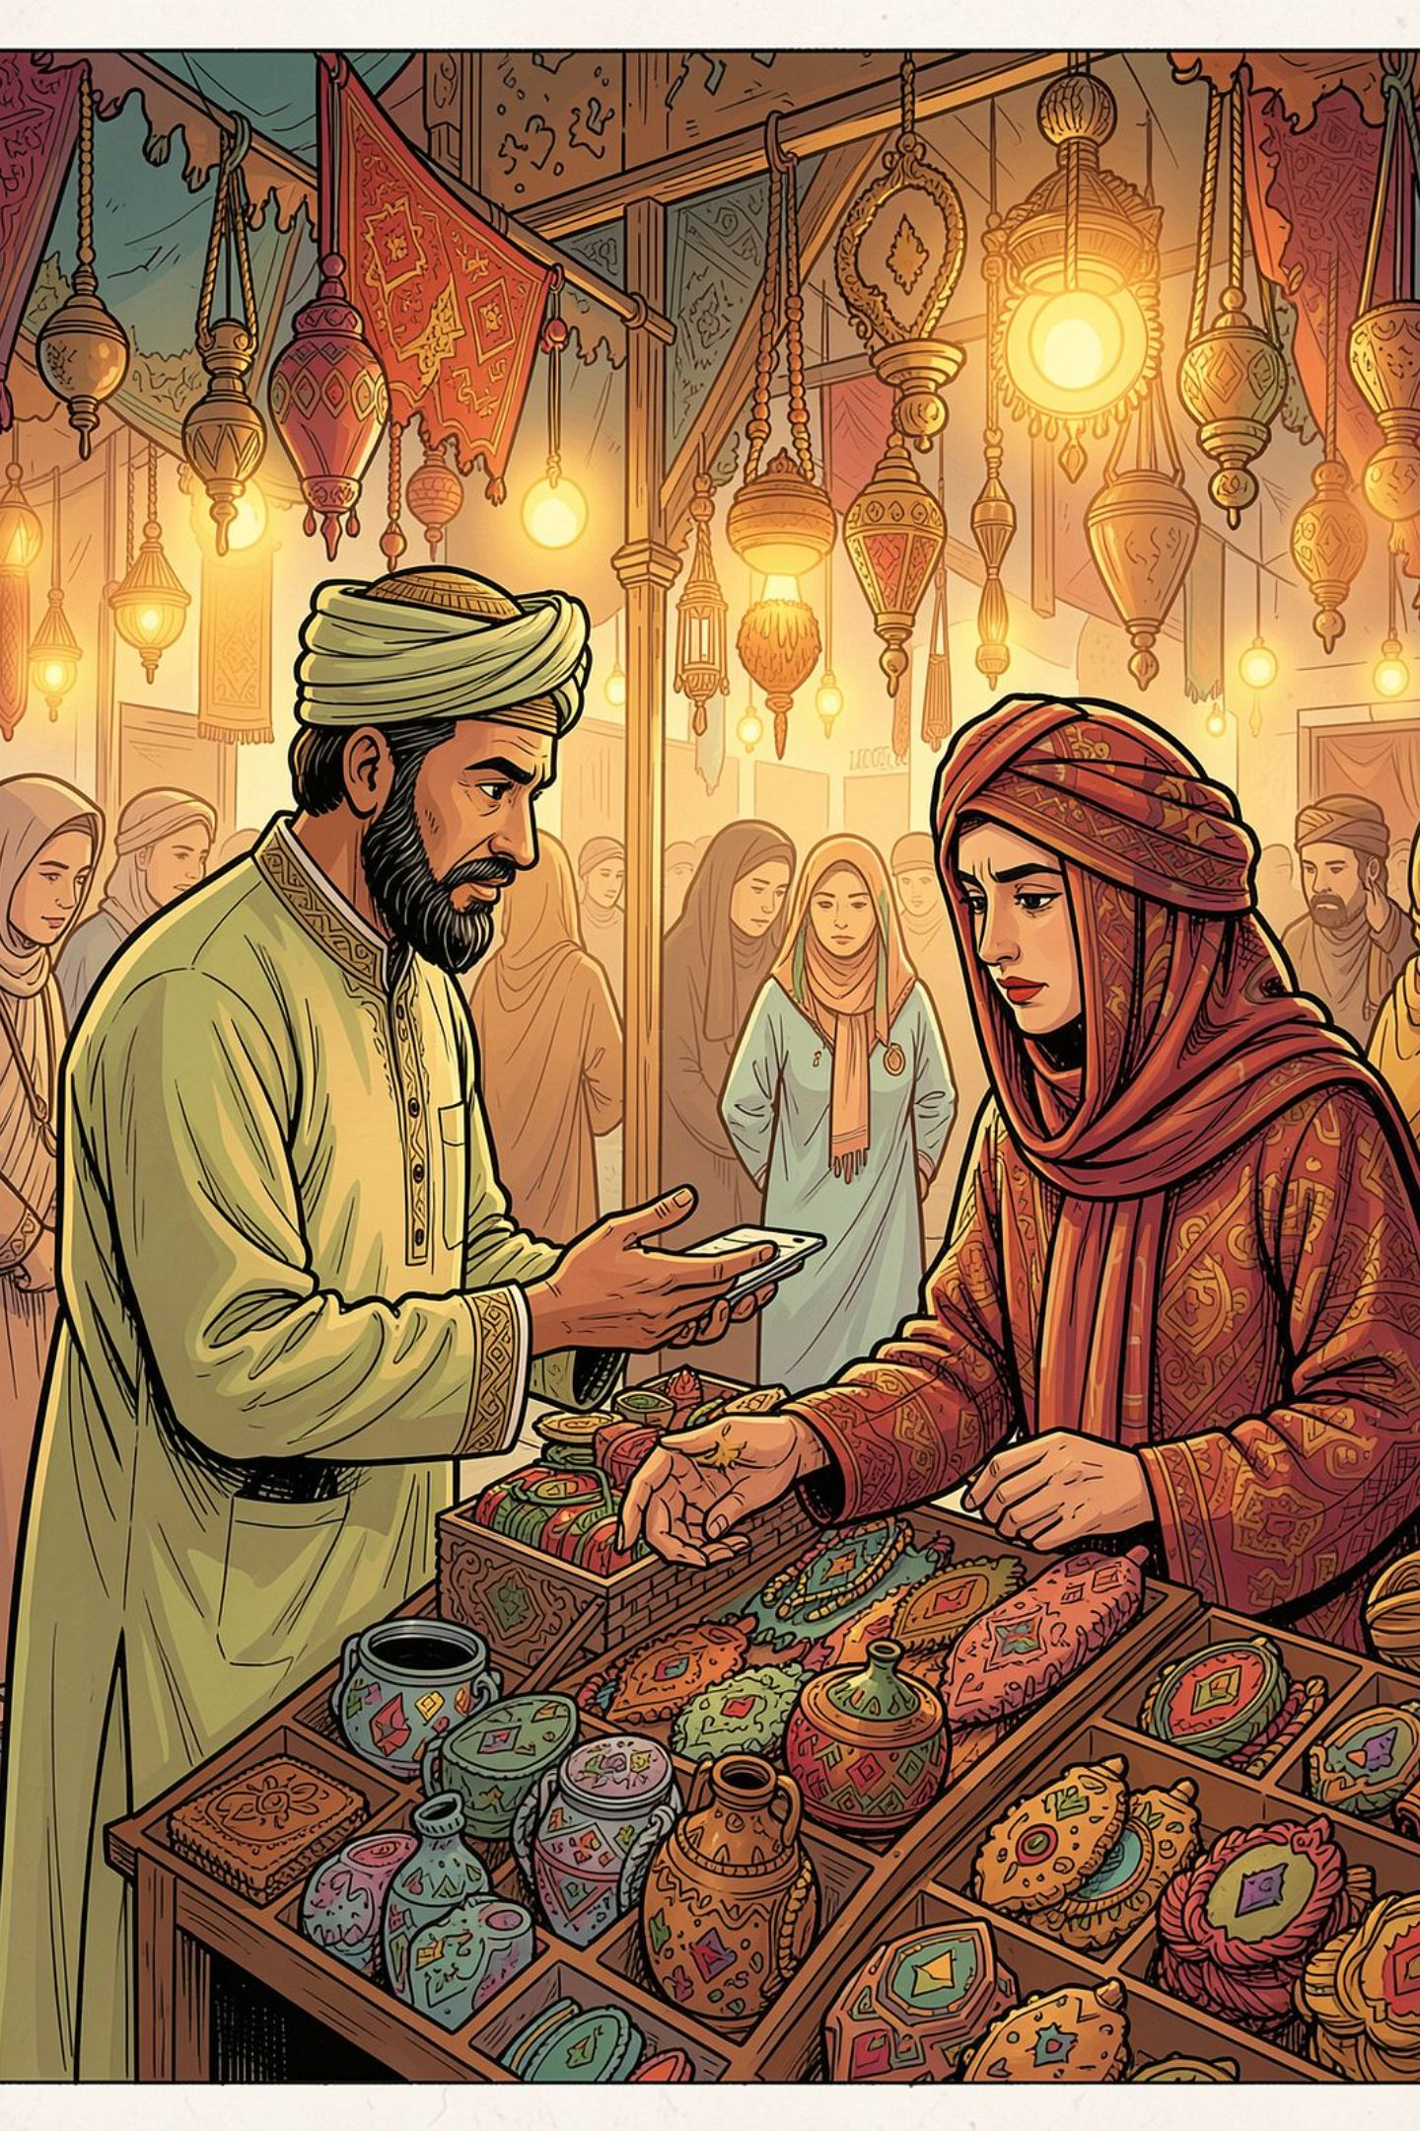

Findings: Accommodation & Language Evaluation
Accommodation Runs Toward the Customer
7 of 8 non-Indonesian interviews were conducted wholly in BI. P12 conducts price negotiations in BI unprompted; P13 counts in Javanese numerals. P10 claims "I can't speak BI" — in fluent BI.
Arabic Internally Differentiated
P4 classifies colloquial Saudi Arabic as bahasa daerah (regional language) — importing an Indonesian taxonomy to describe Arabic diglossia, narrowing its perceived scope while preserving liturgical authority.
Regional Languages Valued
Sundanese, Javanese, and Sasak are allocated to intimacy and supplication — not treated as deficient but as differently allocated. P3 reserves Sundanese for the innermost circle of his allocation policy.

Slide 14
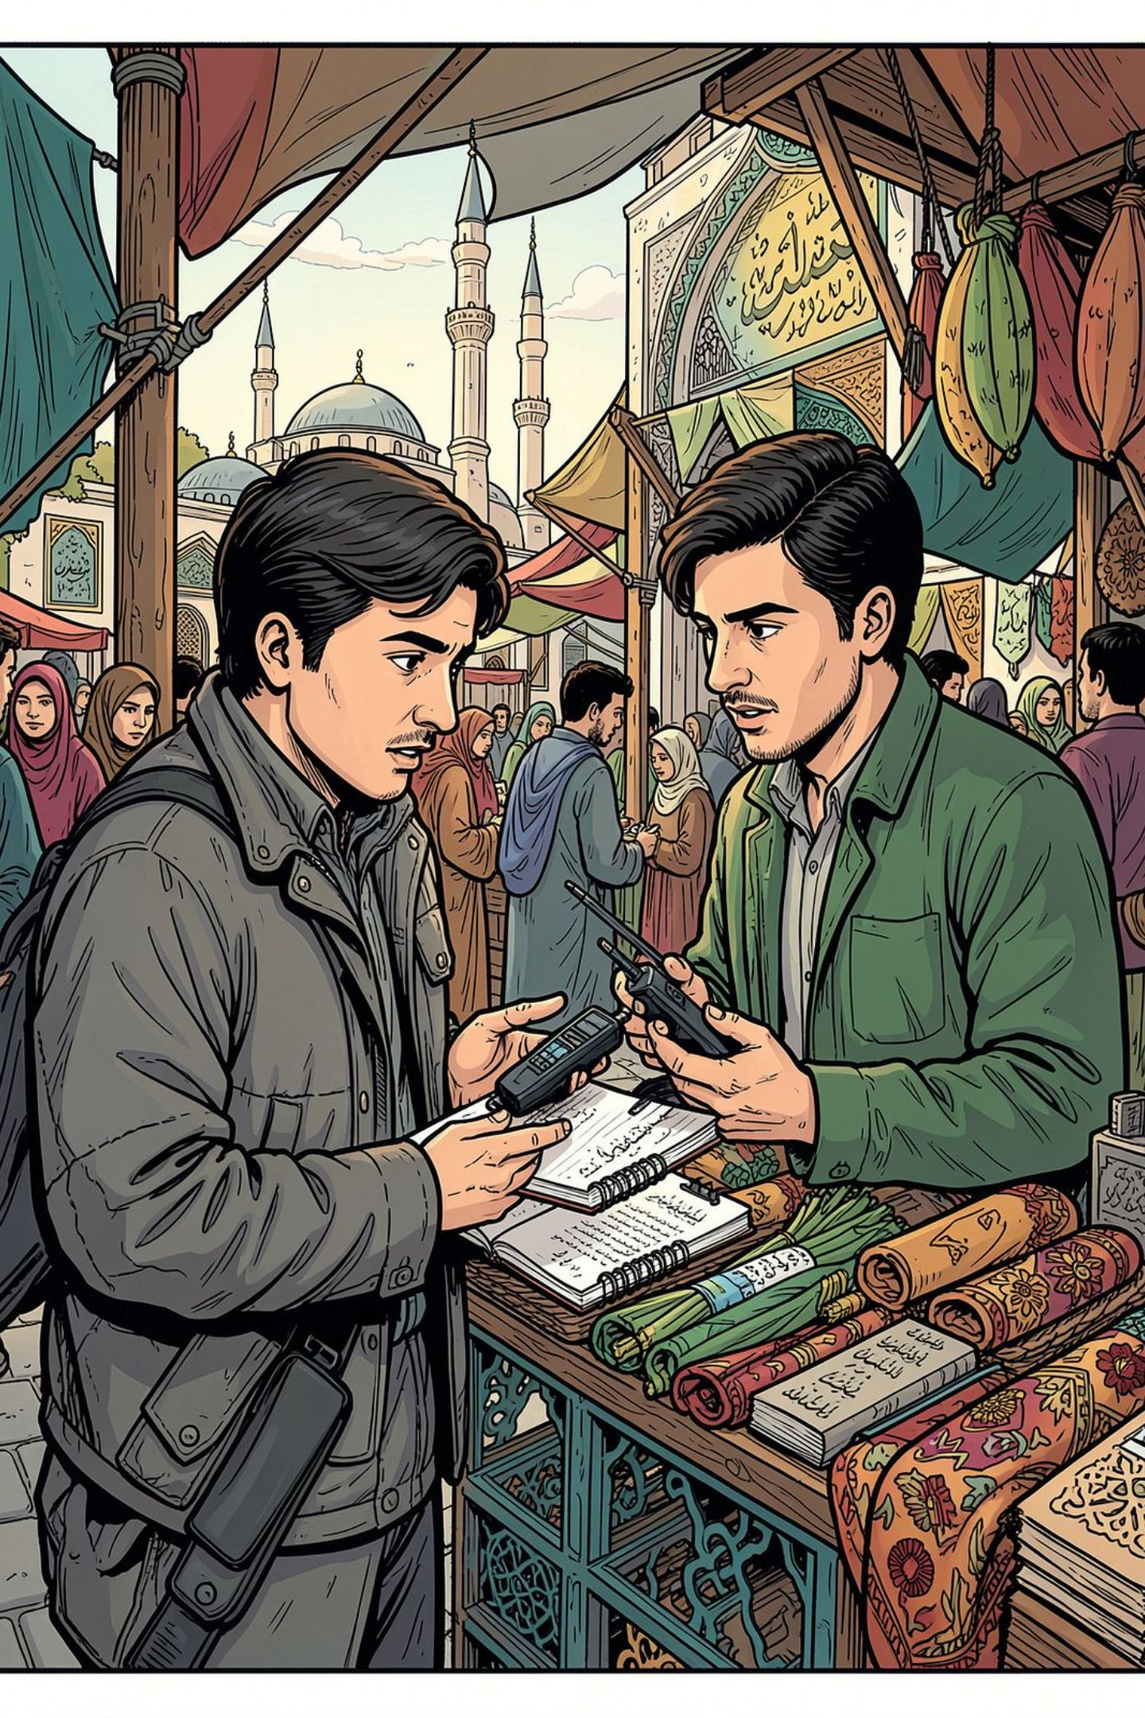
Novelty & Contribution
Unplanned Spread
Domain Theory Tested
A documented case of a national language spreading beyond its borders without policy or institutional support — rare outside English.
Domains are unusually sharply bounded: Arabic's jurisdiction is fixed by ritual, not policy — a clean test case.
Practical Implications
Bears on language preparation for Indonesians traveling to the Kingdom — expectations of Arabic do not match what they encounter.

Slide 15
FINDING 1 – RQ1
The corridor is sharply partitioned by domain
Each situation has its own language
Praying (salat)
Private prayer
Selling to Indonesians
Arabic
Mother tongue
Indonesian
Talking to workmates
Other pilgrims, airport
Home and family
Indonesian
Arabic or English
Regional languages
This is not a ranking. It is a division of work. The same woman who calls Arabic the most beautiful language spends her whole shift speaking Indonesian, and thinks nothing of it.
Notes:
~60s. Read the six boxes quickly, then land the sentence at the bottom. Prestige and use are two different things.

Slide 16
FINDING 2 - Q2
Accommodation runs towards the customer
The seller learns the buyer’s language
A Yemeni worker, asked which language he uses most: “Bukan. Di sini sama kerja, Madinah sama masjid banyak sekali, banyak orang Indonesia.”
No. Here at work, around the mosque in Medina, there are very many Indonesians. His own first language is Arabic.
An Afghan merchant, sixteen years in the country: “Ngak bisa ngomong Bahasa Indonesia.”
I can’t speak Indonesian — said in fluent Indonesian, in the middle of an interview held entirely in Indonesian. He no longer counts it as a skill.
The proof is not only what they told us. Seven of the eight interviews with non-Indonesians were held in Indonesian, with no preparation and no interpreter. Each recording is the thing itself, not a story about it.
Notes:
~70s. The Afghan quote always gets a reaction — pause after it. Then the dark bar: our strongest evidence is the interviews themselves.

Slide 17
FINDINGS 3 - RQ1/RQ2 AND 4 - RQ3
Two smaller findings that change the picture
Workers re-sort Arabic
“Siji loro telu.”
A restaurant worker notices that school Arabic and street Arabic differ, and calls the street one a "bahasa daerah" — the Indonesian word for a regional language.
One, two, three — in Javanese.
A vendor born in Myanmar counts a price in Javanese for an Indonesian customer. So the market has not learned the national language only. It has learned the regional one too. Anyone measuring how far BI has spread by counting standard BI will miss this.
Why that is interesting
That the two differ is old news to linguists. What is new is the label. She sorts Arabic using a category she brought from home — and quietly shrinks the reach of the language she admires.
He also learned Indonesian because he intends to move to Indonesia — an attachment the trade does not require.
Both findings come from single speakers. We report them as illustrations, not as counts.
Notes:
~65s. Say the honesty line at the bottom out loud — it protects you in question time.

Slide 18
FINDING 4 — RQ3
Speakers re-sort Arabic using categories from home
(8) P4, a restaurant worker with pesantren schooling: “di sekolah tuh iya nya tuh na’am, tapi disini ayuwah … Beda. Jadi bahasa daerah.”
At school “yes” is na’am, but here it is aiwah … Different. So it is a regional language.
Not a finding
That the varieties differ is diglossia, described since Ferguson (1959). Our participants are not discovering it.
The finding
The category she reaches for. Bahasa daerah is the Indonesian label for a regional vernacular — imported wholesale to sort a repertoire it was never built for.
P14, with far less schooling, makes the analogy explicit: “beda-beda bahasa Arab … ya kayak kita aja Jawa.”
Notes:
~60s. Pre-empt the obvious objection out loud: yes, this is diglossia and no, that is not our claim. Our claim is about the folk taxonomy that gets applied to it — a national-versus-regional opposition carried from Indonesia and used to narrow the scope of Arabic without ever disputing the Qur’an.

Slide 19
FINDING 5 — RQ1 / RQ3
Devotion, and an attachment beyond trade
(9) P3, Sundanese, 24 years resident
“ngadu sama Alloh pakai Sunda saja, karena Alloh mah lebih mengerti”
to complain to Allah, just Sundanese, because Allah understands better
Also Bengali (P5) and Uzbek mixed with Arabic (P10). Supplication in any language is jurisprudentially permitted — so the datum is not the practice but the fact that speakers defend it.
Evaluating Indonesian itself
“saya suka Bahasa Indonesia, yang bagus-bagus” — P6, unprompted, first language Arabic.
P2 plans to travel to Puncak and Bogor. P13 is learning it because he intends to move to Indonesia.
None of the three is talking about work.
For speakers who acquired BI as an instrument of trade, it has come to carry attachments that trade does not require.
Notes:
~60s. Two halves. Left: vernacular prayer is permitted, so what needs explaining is the apologetic stance, not the practice. Right: the language has outgrown its commercial origin. The dark bar is the sentence to say slowly.

Slide 20
DISCUSSION
Two routes out of a national territory
PLANNED
UNPLANNED
Diplomacy, curriculum, institutions
Purchasing power of pilgrims
UNESCO General Conference, 2023
No agency, no school, no policy
Yields formal recognition
Yields a working register in a dense domain
Measured in agreements and syllabi
Measured in transactions and repertoires
Cooper (1982) asks who adopts what, when, why and how. The corridor answers unusually cleanly: the service workforce adopts a commercial register of Indonesian, as a function of length of employment, because of the aggregate spending of the largest national contingent in the market — on the job, from customers, without instruction.
Notes:
~60s. This is the theoretical payoff. Most discussion of Indonesian going international concerns the left-hand column. We are documenting the right-hand column, and the two produce quite different objects.

Slide 21
Discussion & Conclusion
Answers to Research Questions
Core Contribution
RQ1: BI dominates commerce with Indonesian customers and peer interaction — domain-specific, not overall supremacy.
RQ2: Accommodation runs seller→buyer; for some, beginning to harden into commodification (P12, P13).
RQ3: Participants import Indonesian national language ideology to categorize Arabic; vernacular supplication is permitted but apologetically justified.
A documented case of unplanned language spread driven by purchasing power, not policy — in a setting where the competing prestige language is fixed by religious obligation.
What spreads is not standardized BI but Indonesian-ness as a saleable repertoire, regional layers included.

Slide 22
WHY IT MATTERS
Three reasons this case is worth reporting
1
2
3
A rare kind of spread
A clean test of an old idea
A practical lesson
Languages usually cross borders because a state pushes them. Here nobody pushed. The market did it.
The idea of "language domains" is hard to test in messy cities. Here the boundaries are unusually clear, because one domain — prayer — is fixed by religion.
Indonesians prepare for the trip by studying Arabic. What they meet on the ground does not match what they studied.
Bahasa Indonesia was recognised by UNESCO in 2023 as an official conference language. That was planned. What we describe here was not.
Notes:
~55s. Reason one is the headline. Reason three is the one Indonesian audiences react to: pilgrims study one kind of Arabic and meet another.

Slide 23
TAKING STOCK
Dominance — of a very particular kind
Bahasa Indonesia holds a domain in a foreign linguistic ecology, without displacing Arabic from worship or English from the airport. That is dominance in Fishman’s sense — a language holding a domain — not demographic or institutional supremacy.
Limits
Small, opportunistically recruited corpus — invites market observation.
Synchronic design — invites a longitudinal study.
Interviews mostly in Indonesian — invites comparison with Bahasa Malaysia.
1
Domains partition by function, not prestige
2
Accommodation runs to the buyer, not the sacred code
3
What spreads is a repertoire, not a standard
Terima kasih · شكراً · Thank you
Notes:
~55s. Close on the qualification: we are not claiming Indonesian has taken over Saudi Arabia. We are claiming it holds a domain, and that it got there without anyone planning it. Each limitation points at the study that should follow. Thank you.

